Slide 1
Genome-wide Complex Trait Analysis
Sarah Medland

Slide 2
http://gump.qimr.edu.au/gcta/

Slide 3
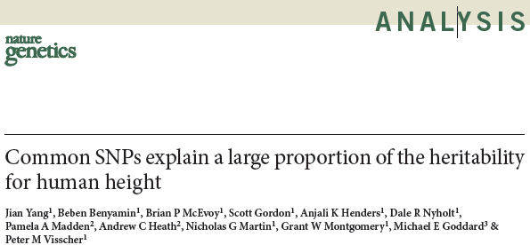

Slide 4
BACKGROUND
Interest in alternate methods of estimating genetic effects

Slide 5
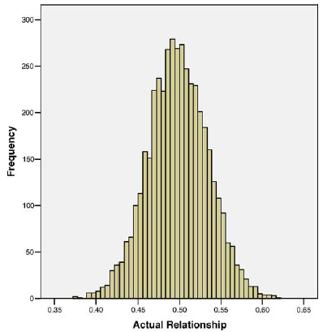
USE IBD variation within SIBS to estimate heritability
Use variation in genetic sharing within a relative type rather than different types of relatives

Slide 6
Application to height

Slide 7
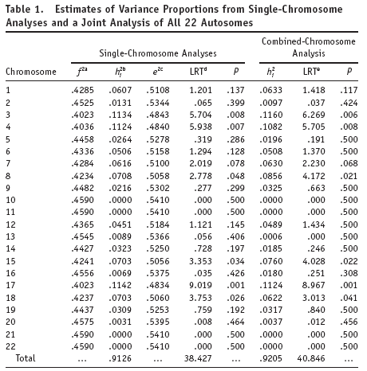
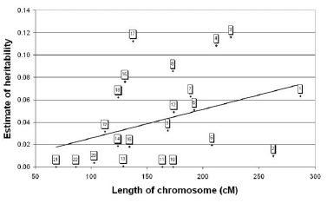
HEIGHT...

Slide 8
GCTA - OBSERVATION
GWAS hits account for only a small fraction of the genetic variation of complex traits in human populations.

Slide 9
GCTA – hypothesis 1
most of the heritability is not missing but has not previously been detected because the individual effects are too small to pass stringent significance tests

Slide 10
GCTA – HYPOTHESIS 2
remaining heritability is due to incomplete linkage disequilibrium between causal variants and genotyped SNPs, exacerbated by causal variants having lower minor allele frequency than the SNPs explored to date

Slide 11
PROCESS
Estimated pairwise genetic relationships using all autosomal markers (MAF ≥ 0.01)
(Effectively acts like a big kinship matirx)
Note: NO LD PRUNING

Slide 12
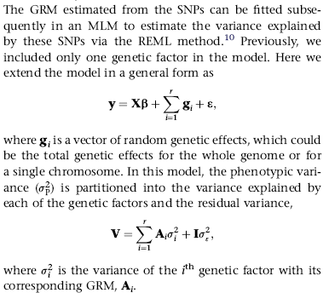
PROCESS

Slide 13
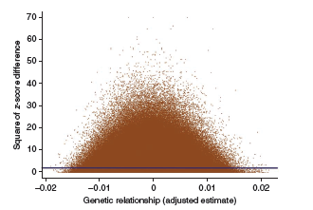
PROCESS
Use variation in genetic sharing among unrelateds rather than different types of relatives
variance explained by the SNPs as 0.45

Slide 14
HEIGHT...
SNPs identified to date explain only ~5% of the phenotypic variance for height at the time - now about 12% with ~200K ple
Common SNPs in total explain another ~40% of phenotypic variance.
Conclusion 88% (40/45) of the variation due to SNPs has been undetected in published GWASs because the effects of the SNPs are too small to be statistically significant.

Slide 15
HEIGHT...
the discrepancy between 80% heritability and 45% accounted for by all SNPs is due to incomplete LD between causal variants and the SNPs
Possibly because the causal variants have a lower MAF on average than the SNPs typed on the array.

Slide 16
CLARIFICATION
Common interpretation that this estimates heritability
It provides an estimate of the variance explained by the SNPs in total
NOT
an estimate of the ‘true’ heritability

Slide 17
ONCE AGAIN...
The method implemented in GCTA is designed to estimate the variance explained by chromosome- or genome-wide SNPs rather than the trait heritability.
Tells you nothing about the # of variants influencing a trait or the size of these effects

Slide 18
Prac
Commands.txt
Unselected sample 2000 individuals
Simulated data (thanks Ben)

Slide 19
Prac
#Estimation of the genetic relationship matrix (GRM) from all the autosomal SNPs
gcta64 --bfile sim --autosome --maf 0.01 --make-grm --out test
#remove cryptic relatedness
gcta64 --grm test --grm-cutoff 0.05 --make-grm --out test_rm05
#Principal component analysis
gcta64 --grm test --pca 5 --out test_pca
#make phenotype file
awk '{print $1, $2, $6}' sim.fam > test.phen
#Estimation of the variance explained by the SNPs
gcta64 --grm test_rm05 --pheno test.phen --reml --out test_var
#Include the PCA results as covariates
gcta64 --grm test_rm025 --pheno test.phen --reml --out test_cov --qcovar test_pca.eigenvec

Slide 20
Results
Data simulated so that 30% of the trait variance can be explained by common risk factors.
GCTA estimate .37% of total variance

Slide 21
ISSUES
Need very large data sets of unrelated individuals
Need access to raw genotypes – not summary stats
Doesn’t work well on imputed data so you need participants to be typed on the same chip...

Slide 22
Question
The trait being studied has a heritability of 60% from twin/family studies
You find an important genetic variant that explains 5% of the total variance
When writing the paper can you say that this 5% effect explains ~8% of the heritability and that the unexplained heritability is now 55% of the total variance
YES
NO
MAYBE

Slide 23
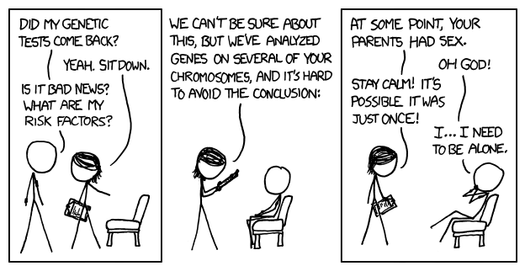
TIME FOR COFFEE

