Slide 1
Complexities of complex trait genetics
Nick Martin
With thanks to Dorret Boomsma, Sarah Hartz, Jodie Painter
Boulder workshop
March 11, 2011

Slide 2
Friday outline - Phenomics
9.00 Mike / Nick: intro including comorbidity, pleiotropy, endophenotypes (results from based on biology)
10.00 Hermine / Meike: multivariate phenotypes practical in Mx/openMx: multivariate example (Attention Problems in kids; multiple raters and multiple time points, results to be used in second prac)
11.00 Dorret / Meike / Hermine: Multivariate data with 1 or more SNP (intro and practical) Continuous data
13.30 Sarah / Mike / Shaun: plink for association analysis in relatives (attention data again) addiction data: SNP with opposite effects on different phenotypes. Ordinal data & thresholds
15.30 Lindon : Wrap up – the Grand Scheme
16.30 Close
18.30 Party at John & Christine Hewitt’s (bus 6pm from lobby)

Slide 3
How do gene effects vary...
Across correlated traits/diseases
For the same trait/disease
  Longitudinally (development, ageing)
  Between cohorts (secular trends)
  Between environments (?) – G x E
  Between different disease forms/severities

Slide 4
Tools
Inspection of GWAS results (meta-analysis, replication)
Structural equation modelling
Genetic prediction functions
Genome-wide Complex Trait Analysis (GCTA)
Genetic factor scores
IRT modelling
Causal models

Slide 5
Pleiotropy
The same gene(s) affecting multiple traits/diseases
What are the genetic [and environmental] causes of:
  Covariation between continuous traits?
  Comorbidity between diseases?

Slide 6
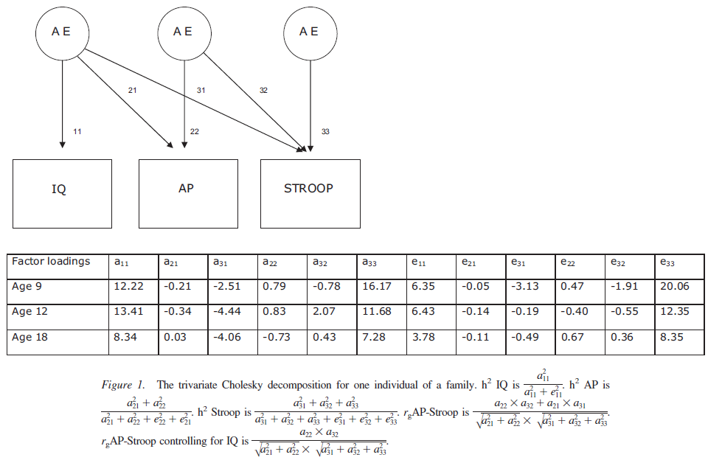

Slide 7
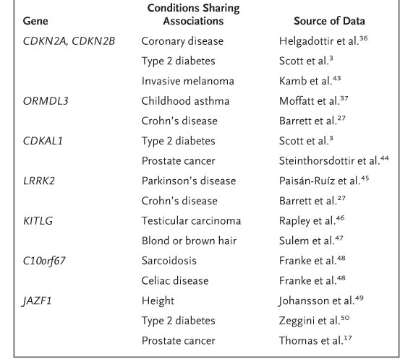
Examples of loci shared by conditions or traits previously thought to be unrelated, according to Genomewide Association Studies
Manolio T. N Engl J Med 2010;363:166-176

Slide 8
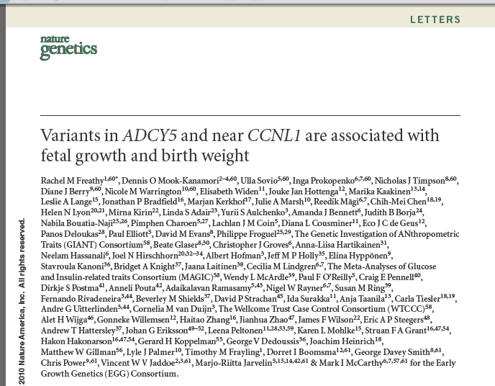
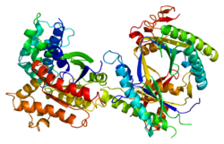
Adenylate cyclase type 5 is an enzyme that has been shown to interact with RGS2

Slide 9
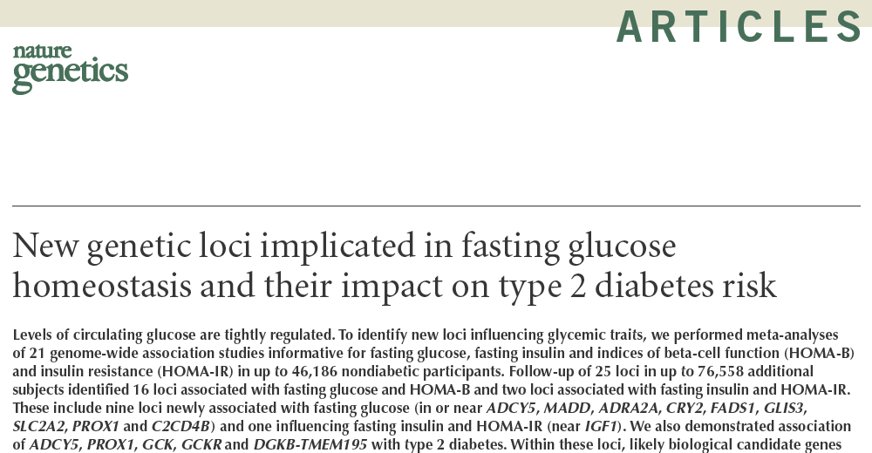

Slide 10

birth weight and glucose
Meta-analysis of six GWA studies (n = 10,623 Europeans).
Two lead signals were followed up (n = 27,591): rs900400 near LEKR1 and CCNL1 (P = 2 × 10−35) and rs9883204 in ADCY5 (P = 7 × 10−15) were associated with BW.
Correlated SNPs in ADCY5 were recently implicated in regulation of glucose levels and susceptibility to type 2 diabetes, providing evidence that the well-described association between lower birth weight and T2D has a genetic component, distinct from the proposed role of programming by maternal nutrition.
Barker hypothesis: low birth weight is a risk factor for cardiovascular disease, type 2 diabetes, ..

Slide 11
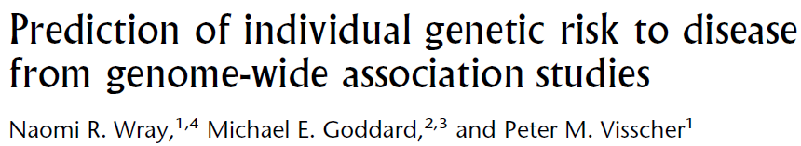


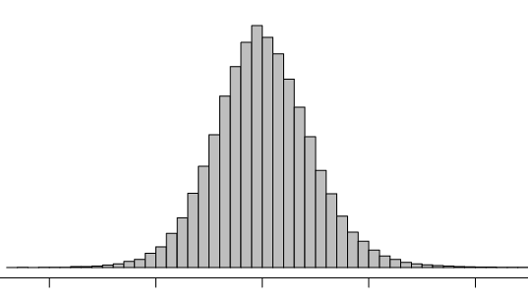
Looking for the effect of all tagged SNPs on comorbidity
Genome Research 2007 17:1520
GWAS
Case-Control
“Discovery
Set”
GWAS
Population
“Target
Set”
Accuracy of
Prediction of
Genetic risk
Top SNPs
Risk alleles
Genomic profile
Sum risk alleles
Accurate prediction of genetic risk possible if discriminating genetic variants are identified in a very large sample size: 10,000 cases and 10,000 controls

Slide 12
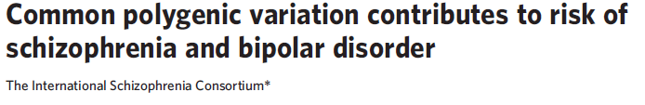

P=2×10⁻²⁸
ISC
X
Test
R²
A greater load of “nominal”
schizophrenia alleles (from ISC)?
5×10⁻¹¹
1×10⁻¹²
7×10⁻⁹
Purcell, Wray et al, Nature, 2009
0.008
0.71
0.05
0.65
0.23
0.06
0.30
MGS
Euro.
MGS
Af-Am
O’Donovan
STEP-BD
WTCCC
CAD
CD
HT
RA
T1D
T2D
Schizophrenia
Bipolar disorder
Non-psychiatric (WTCCC)

Slide 13
How do gene effects vary..
Across correlated traits/diseases
For the same trait/disease
  Longitudinally (development, ageing)
  Between cohorts (secular trends)
  Between environments (?) – G x E
  Between different disease forms/severities

Slide 14
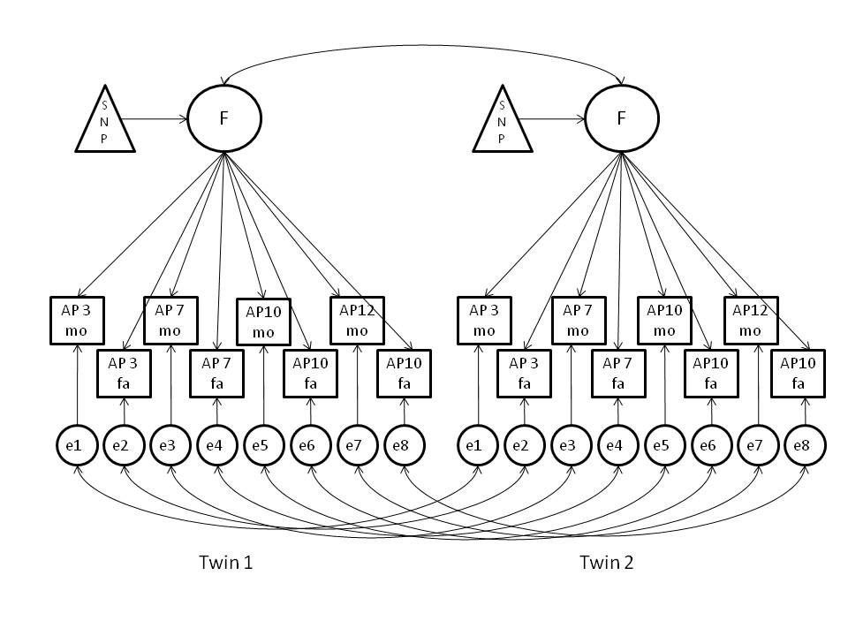
SEM for effect of one SNP on the same trait across development

Slide 15
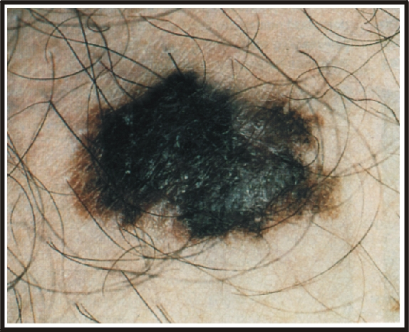
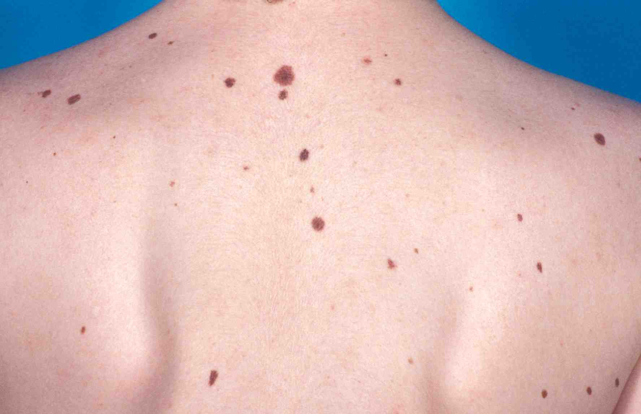
Melanocytic naevi
(common moles)
The largest risk factor for melanoma

Slide 16
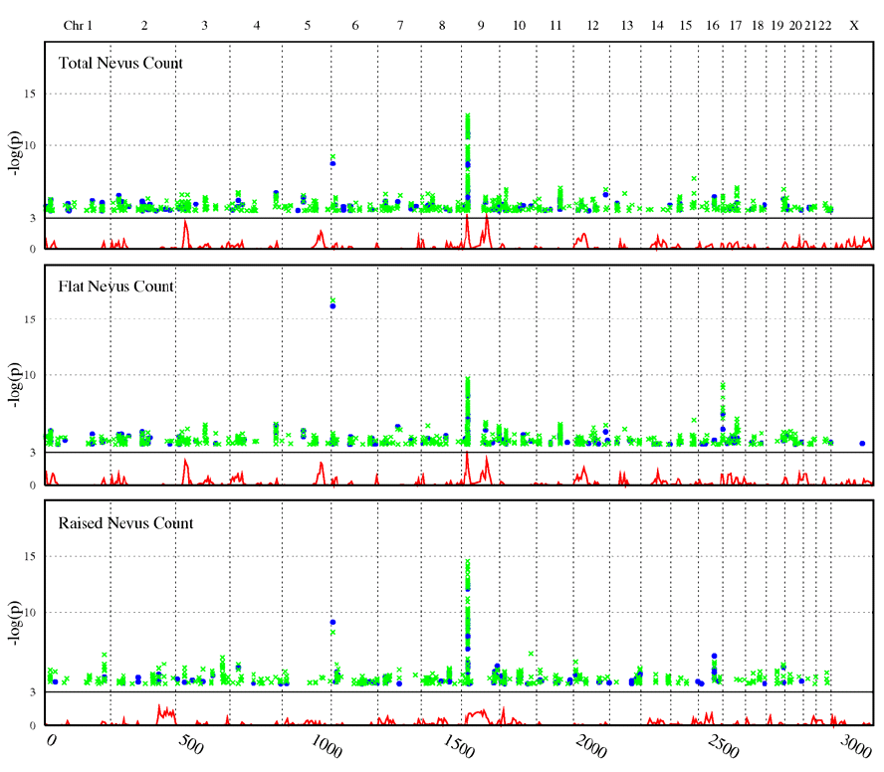

QIMR GWAS for total, flat and raised nevi
IRF4
MTAP
Note inverse association signals for MTAP and IRF4 with flat and raised nevi

Slide 17
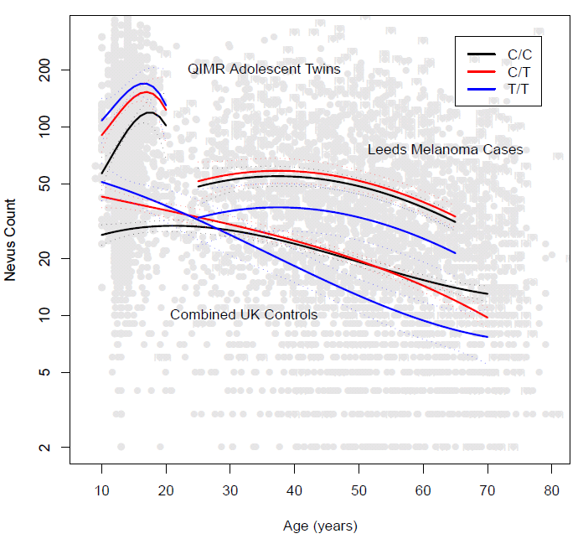


Mole count: Interaction of IRF4 genotype with age
American Journal of Human Genetics 87, 6–16, 2010

Slide 18
How do gene effects vary..
Across correlated traits/diseases
For the same trait/disease
  Longitudinally (development, ageing)
  Between cohorts (secular trends)
  Between environments (?) – G x E
  Between different disease forms/severities

Slide 19
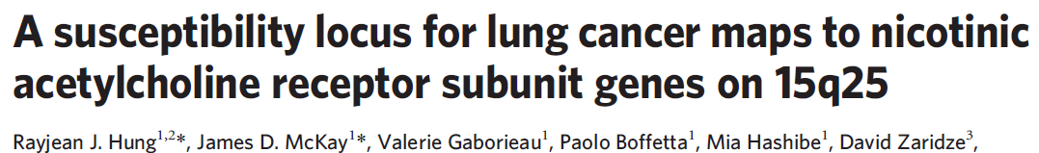
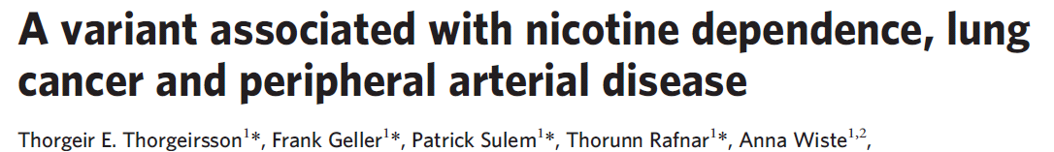
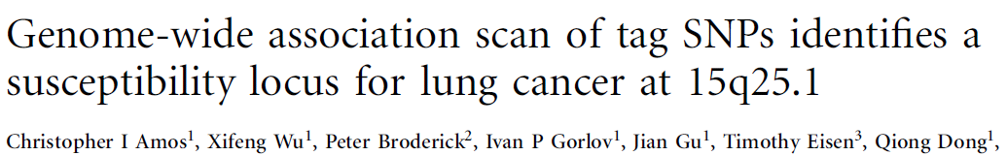
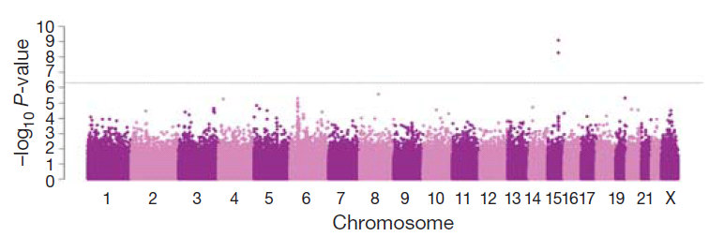

Slide 20
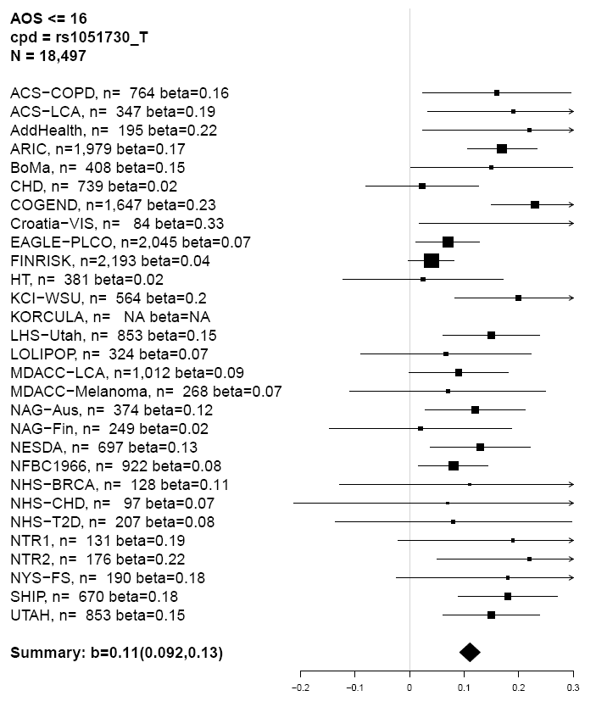
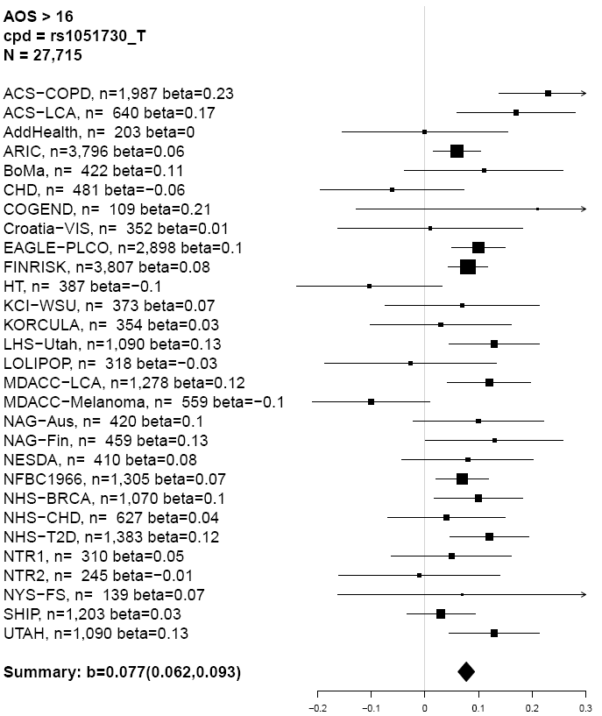
Association between CPD and rs1051730 across studies where subjects are stratified by age of onset of regular smoking (AOS) at or before age 16 versus after age 16. P-value for difference between meta-analysis betas for the two AOS strata is 0.006.
Sarah Hartz

Slide 21
Notes:
Each point is the meta-analysis beta parameter and sd for the regression between cpd and rs1051730, stratified for 20 year birth cohort and gender. This is US data only. We see a near doubling of the in the 60’s and 70’s birth cohort there is a near doubling of the betas from the 40’s & 50’s birth cohort.
Including the European sample decreased this cohort effect dramatically.

Slide 23
How do gene effects vary..
Across correlated traits/diseases
For the same trait/disease
  Longitudinally (development, ageing)
  Between cohorts (secular trends)
  Between environments (?) – G x E
  Between different disease forms/severities

Slide 24
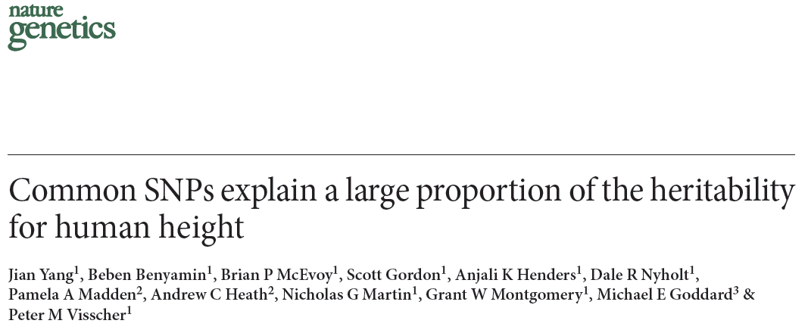
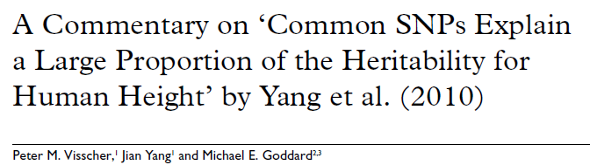
Yang, J., Lee, S.H., Goddard, M.E., and Visscher, P.M. (2011).
GCTA: A tool for genome-wide complex trait analysis. Am.
J. Hum. Genet. 88, 76–82. http://gump.qimr.edu.au/gcta

Slide 25
Genome-wide association study for endometriosis
Genotyping endometriosis cases on Illumina 610K chips
  3194 cases: 2270 QIMR, 924 Oxford
Controls from WTCCC (1M) and QIMR (610K)
  7060 controls: 5190 UK, 1870 Australian
Stage and other phenotypic data available
  Stage A (minimal-mild endometriosis): 1686 cases (52.7%)
  Stage B (moderate-severe endometriosis): 1364 cases (42.7%)
  Unknown (UK only): 144 (4.6%)

Slide 26
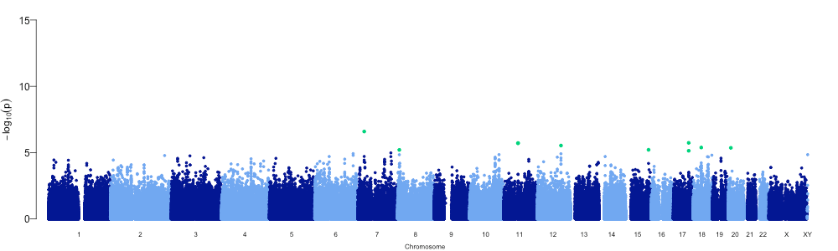
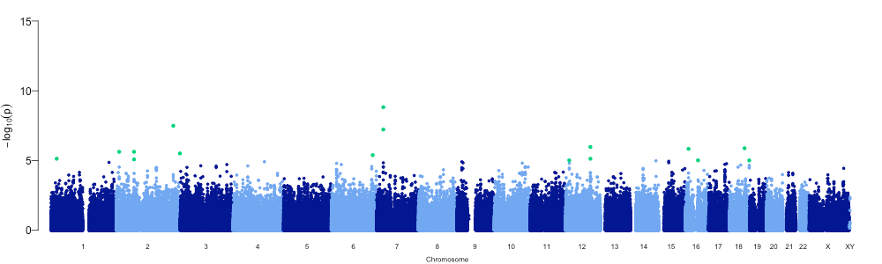
“All” endometriosis
“Stage B” endometriosis
Painter et al., (2010) unpublished data

Slide 27
Genetic loading in stage A vs stage B
Novel method uses ALL SNPs simultaneously (following rigorous QC)
  Yang et al. (2010) Nature Genetics 42:565-569
Calculate realized levels of relatedness between individuals
  Remove all ‘actual’ relatives (≥ 0.05)
Linear mixed models to calculate proportion of variation attributable to case status
  Background relatedness in cases vs controls
Phenotypes | Cases | Controls | Proportion of variation (SE) | P value
All endometriosis | 3154 | 6981 | 0.27 (0.04) | 4.4 x 10⁻¹⁶
Stage A | 1666 | 6981 | 0.15 (0.04) | 2.6 x 10⁻⁴
Stage B | 1347 | 6981 | 0.34 (0.04) | 4.4 x 10⁻¹⁶
Supported by separate prediction analysis using Oxford as discovery, QIMR as target
Painter et al., (2010) unpublished data

