Slide 1











24th International Workshop on Methodology for Human Genomic Studies: “the Advanced course”
Pak Sham (director)
Lindon Eaves
Jeff Barrett
David Evans
John Rice
Goncalo Abecasis
Mike Neale
Hermine Maes
Sarah Medland
Dorret Boomsma
Danielle Posthuma
Meike Bartels
John Hewitt (host)
Jeff Lessem
Matt Keller
Clara Tang
Stacey Cherny
Ben Neale
Shaun Purcell
Manuel Ferreira
Nick Martin
Kai Ye
Hyun Min Kang

Slide 2

The genetics of complex traits: historical context and current challenges
Nick Martin
Queensland Institute
of Medical Research
Brisbane
Dorret Boomsma
VU Univ, Amsterdam
Boulder workshop
March 7, 2011

Slide 3
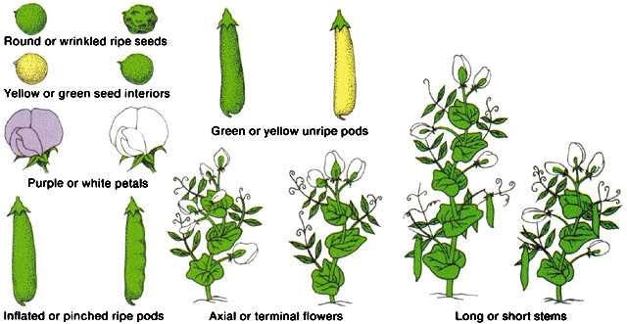
Mendel 1865 – genetics of discrete traits

Slide 4
But (despite appearances) humans are not like peas
………

Slide 5
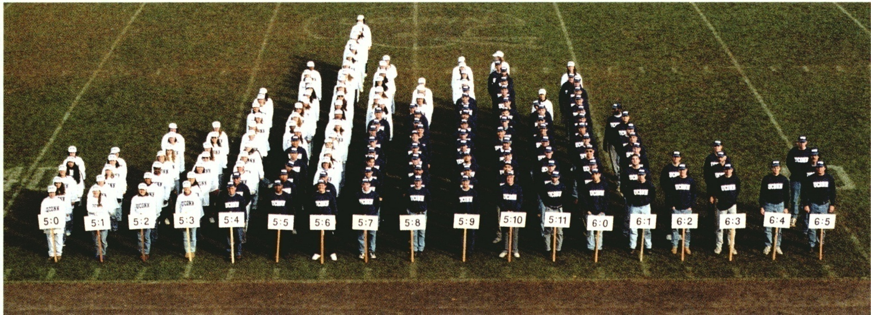

Slide 6
R.A. Fisher, 1918
The explanation of quantitative inheritance in Mendelian terms
1 Gene
→ 3 Genotypes
→ 3 Phenotypes
2 Genes
→ 9 Genotypes
→ 5 Phenotypes
3 Genes
→ 27 Genotypes
→ 7 Phenotypes
4 Genes
→ 81 Genotypes
→ 9 Phenotypes

Slide 7
Genetic Epidemiology:
Stages of Genetic Mapping
Are there genes influencing this trait?
  Genetic epidemiological studies
Where are those genes?
  Linkage analysis
What are those genes?
  Association analysis
How do they work beyond the sequence?
  Epigenetics, transcriptomics, proteomics
What can we do with them ?
  Translational medicine

Slide 8
Twin correlations for IQ in Dutch twins
Notes:
Ik wil dit model direct toepassen op een eigenschap die zich hier bij uitstek voor leent: cognitieve vaardigheden zijn hoog erfelijk en ondanks vele pogingen zijn er nog geen genen ontdekt die verschillen tussen mensen in cognitieve vaardigheden kunnen verklaren.
Aan de VU zijn in de loop der jaren honderden tweelingparen getest en is een schat aan informatie verzameld op het gebied van cognitieve vaardigheden en hersenfunctioneren. Er is informatie beschikbaar op reactietijdtaken, EEG metingen, MRI metingen en ook intelligentie testen. Wanneer we bijvoorbeeld de IQ score van een lid van een tweelinpaar afzetten tegen de IQ score van het tweede lid van een paar, en we doen dat apart voor eeneiige tweelingen en tweeeiige tweelingen, dan zien we dat de eeneiige tweelinparen ongeveer twee keer zoveel op elkaar lijken (corr .80) als de tweeeiige paren (met een corr van .45). Dit correlatiepatroon leid tot hoge erfelijkheidsschattingen en is in overeenstemming met een aantal versch modellen die deze erf kunen verklaren:
1
2
3
4

Slide 9
Multifactorial Threshold Model
of Disease
Multiple thresholds
Single threshold
unaffected affected
normal
mild
mod
severe
Disease liability
Disease liability

Slide 10
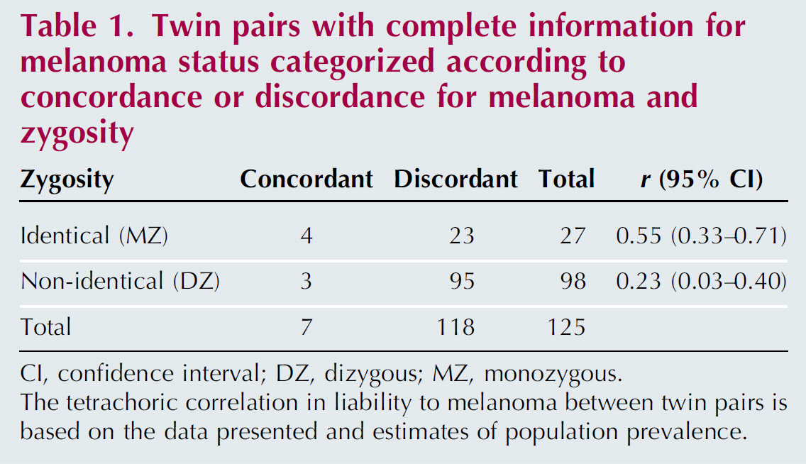
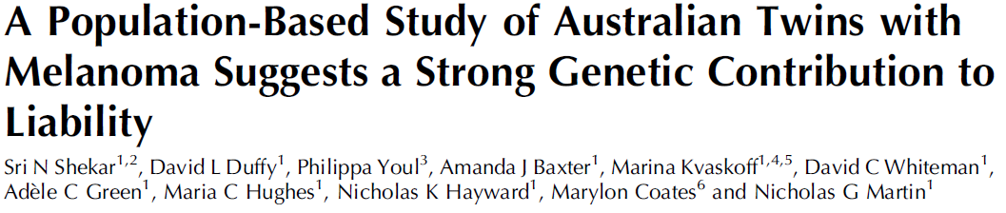
Twins show melanoma risk is heritable

Slide 11
4 Stages of Genetic Mapping
Are there genes influencing this trait?
  Genetic epidemiological studies
Where are those genes?
  Linkage analysis
What are those genes?
  Association analysis
What can we do with them ?
  Translational medicine

Slide 12
Linkage analysis
Thomas Hunt Morgan – discoverer of linkage

Slide 13
Linkage = Co-segregation
A₁A₂
A₃A₄
A₁A₃
A₂A₄
A₂A₃
Marker allele A₁
cosegregates with
dominant disease
A₁A₂
A₁A₄
A₃A₄
A₃A₂

Slide 14
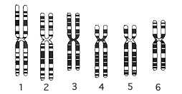



Linkage Markers…

Slide 15
x
1/4
1/4
1/4
1/4

Slide 16
IDENTITY BY DESCENT
Sib 1
Sib 2
4/16 = 1/4 sibs share BOTH parental alleles IBD = 2
8/16 = 1/2 sibs share ONE parental allele IBD = 1
4/16 = 1/4 sibs share NO parental alleles IBD = 0

Slide 17
For disease traits (affected/unaffected)
Affected sib pairs selected
1000
750
500
250
Expected
1
2
3
127
310
IBD = 2
IBD = 1
Markers
IBD = 0

Slide 18
For continuous measures
Unselected sib pairs
1.00
0.75
Correlation between sibs
0.50
0.25
0.00
IBD = 0
IBD = 1
IBD = 2

Slide 19
r_{MZ} = r_{DZ} = 1
r_{MZ} = 1, r_{DZ} = 0.5
E
E
^
C
r_{MZ} = 1, r_{DZ} = π
C
e
e
c
A
A
c
a
Q
Q
a
q
q
Twin 1 mole count
Twin 2 mole count

Slide 20
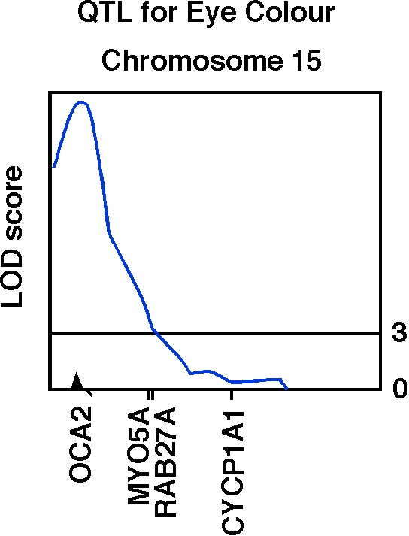
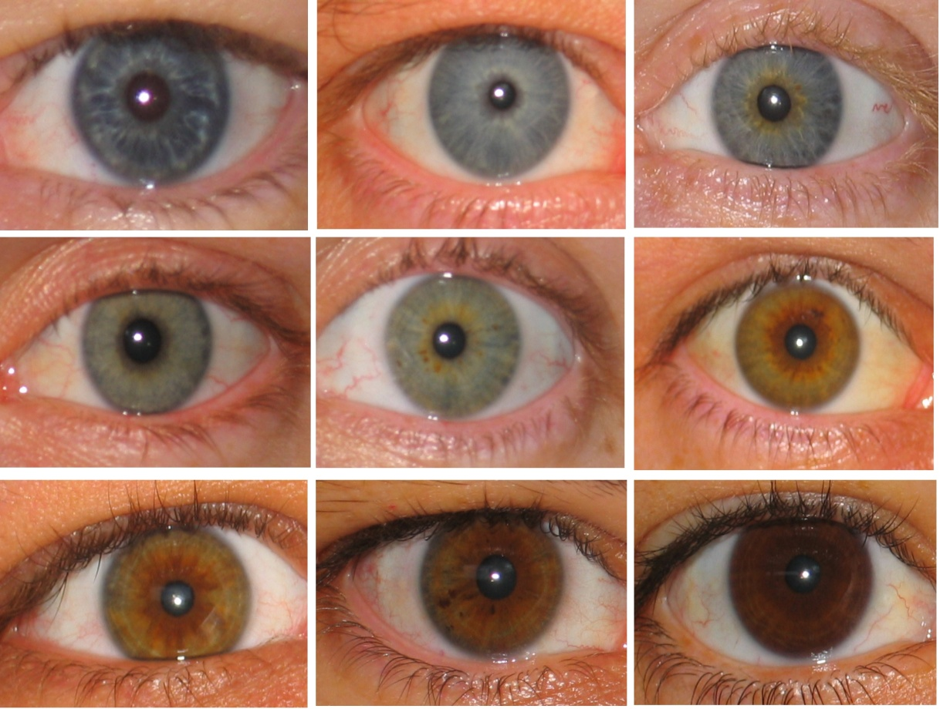
Human OCA2 and eye colour
Zhu et al., Twin Research 7:197-210 (2004)

Slide 21
r_{MZ} = 1, r_{DZ} = 0.25
r_{MZ} = 1, r_{DZ} = 0.5
E
E
^
D
r_{MZ} = 1, r_{DZ} = π
D
e
e
c
A
A
c
a
Q
Q
a
q
q
Twin 1 pheno-
type
Twin 2
pheno-
type

Slide 22
Genome-wide IBD
Why use the average sib values of r_{a} = 0.5 r_{d} = 0.25 when we can estimate the (almost) exact values for each sib pair from marker data ?

Slide 23
Mean IBD sharing across the genome for the jth sib pair was based on IBD estimated from Merlin every centimorgan and averaged at all 3491 points
additive
dominance

Slide 24
Application
Phenotype = height
Number of sibpairs with phenotypes
and genotypes
Adolescent cohort 931
Adult cohort 2444
Combined 3375

Slide 25
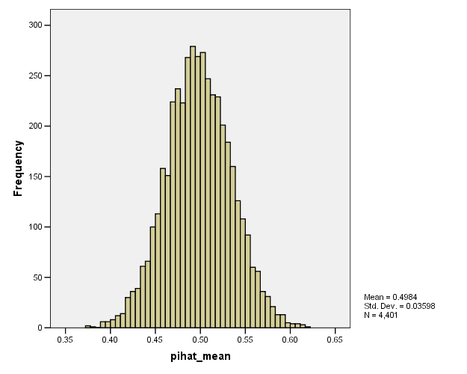
Mean and SD of genome-wide additive relationships

Slide 26
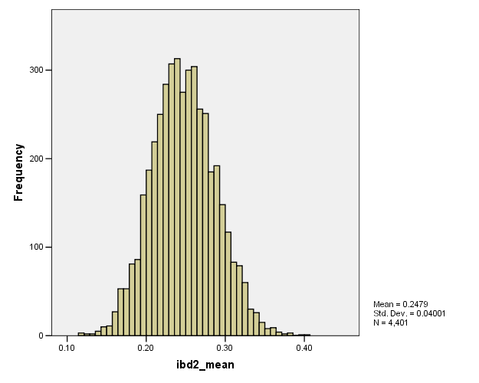
Mean and SD of genome-wide dominance relationships

Slide 27
Estimates of heritability using Genome-Wide IBD
Adolescent 0.80 (0.36 – 0.90)
Adult 0.80 (0.61 – 0.86)
Combined 0.80 (0.62 – 0.85)
~Estimates of heritability from twin and family studies
Genome partitioning of genetic variation for height from 11,214 sibling pairs.
Visscher PM, et al Am J Hum Genet. 2007 Nov;81(5):1104-10.

Slide 28
Finding the genes - association
Looks for correlation between specific alleles and phenotype (trait value, disease risk)

Slide 29
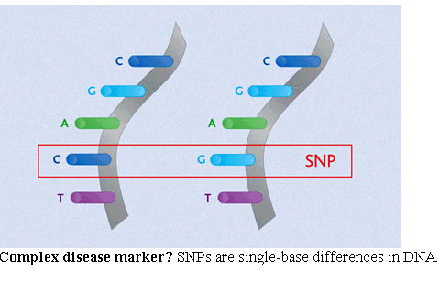
Variation: Single Nucleotide Polymorphisms

Slide 30
How do we test for association?
We use “tag SNPs” that are correlated (in linkage disequilibrium) with causal variants

Slide 31
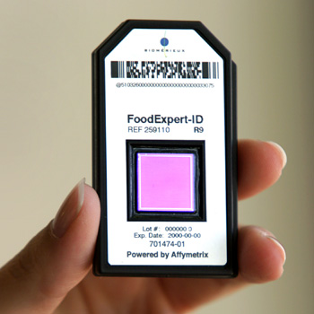
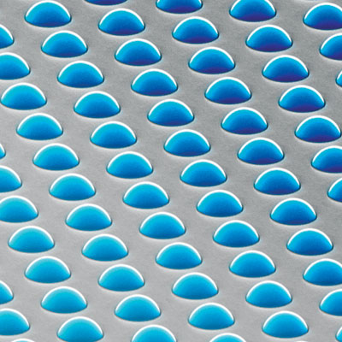
High density SNP arrays – up to 1 million SNPs

Slide 32
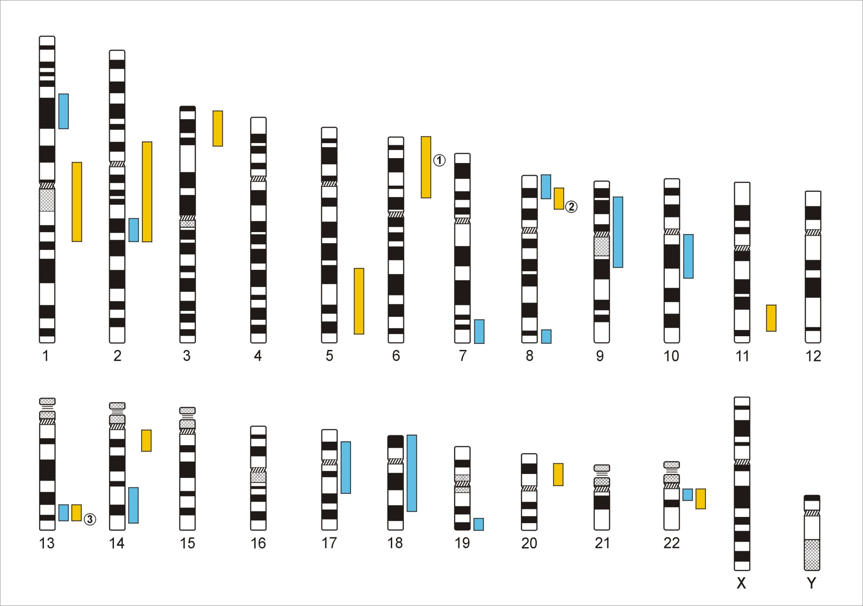
Genome-Wide Association Studies
500,000 – 5,000,000 SNPs
Human Genome - 3,1x10⁹ Base Pairs
Notes:
In a GWA the Genome which contains xx SNPs is examined using … SNPs

Slide 33
Genetic Case Control Study
Controls
Cases
G/T
G/G
T/T
T/T
T/T
T/G
T/G
T/T
T/G
T/G
G/G
T/G
T/G
T/T
Allele G is ‘associated’ with disease

Slide 34
Allele-based tests (case-control)
Each individual contributes two counts to 2x2 table.
Test of association
where
X² has χ² distribution with 1 degrees of freedom under null hypothesis.
 | Cases | Controls | Total
G | n_{1A} | n_{1U} | n_{1·}
T | n_{0A} | n_{0U} | n_{0·}
Total | n_{·A} | n_{·U} | n··

Slide 35
Genotypic tests (case-control)
SNP marker data can be represented in 2x3 table.
Test of association
where
X² has χ² distribution with 2 degrees of freedom under null hypothesis.
 | Cases | Controls | Total
GG | n_{2A} | n_{2U} | n_{2·}
GT | n_{1A} | n_{1U} | n_{1·}
TT | n_{0A} | n_{0U} | n_{0·}
Total | n_{·A} | n_{·U} | n··

Slide 36
Simple Regression Model of Association
(continuous trait)
Y_{i} = α + βX_{i} + e_{i}
where
Y_{i} = trait value for individual i
X_{i} = number of ‘A’ alleles an individual has
1.2
1
0.8
Y
0.6
0.4
0.2
0
X
0
1
2
Association test is whether β > 0

Slide 37
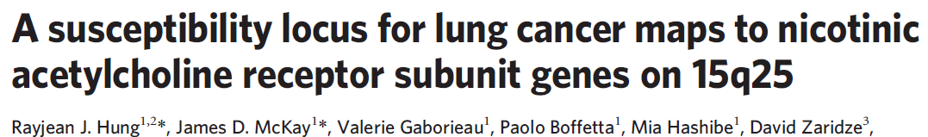
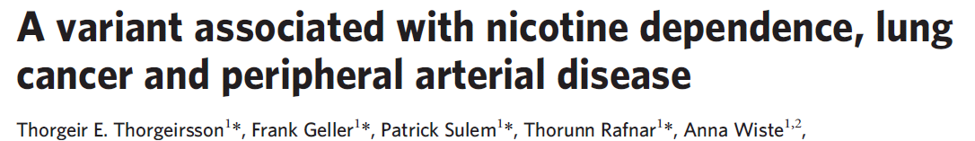
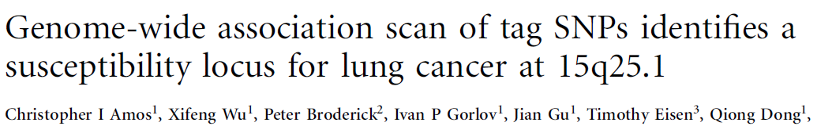
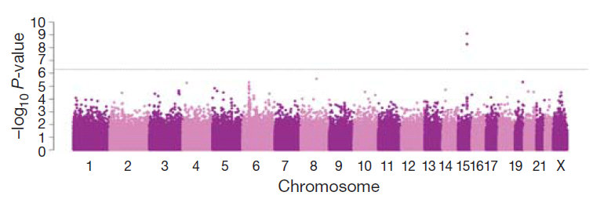

Slide 38
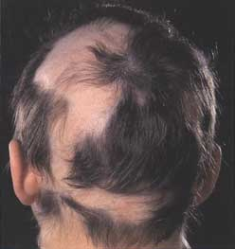
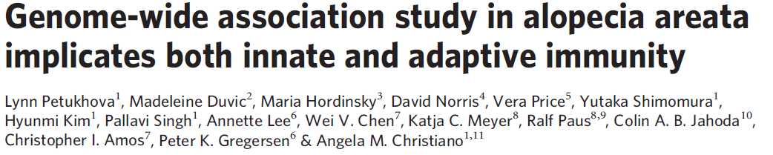
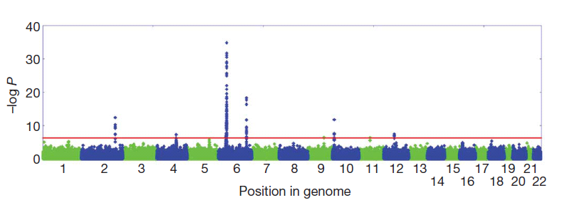

Slide 39
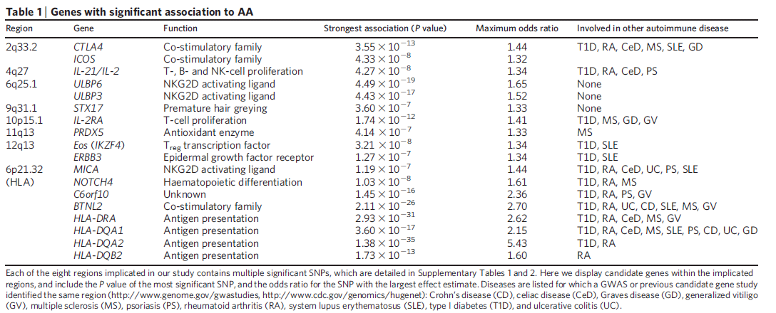
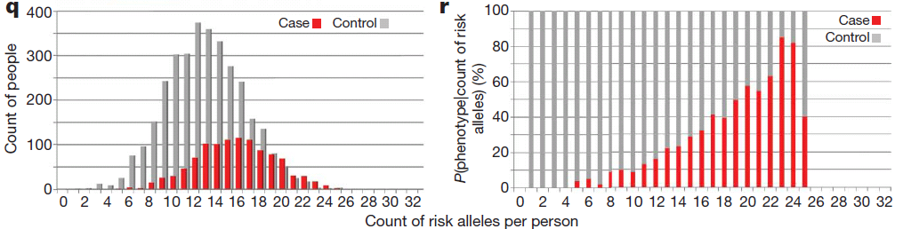

Slide 40
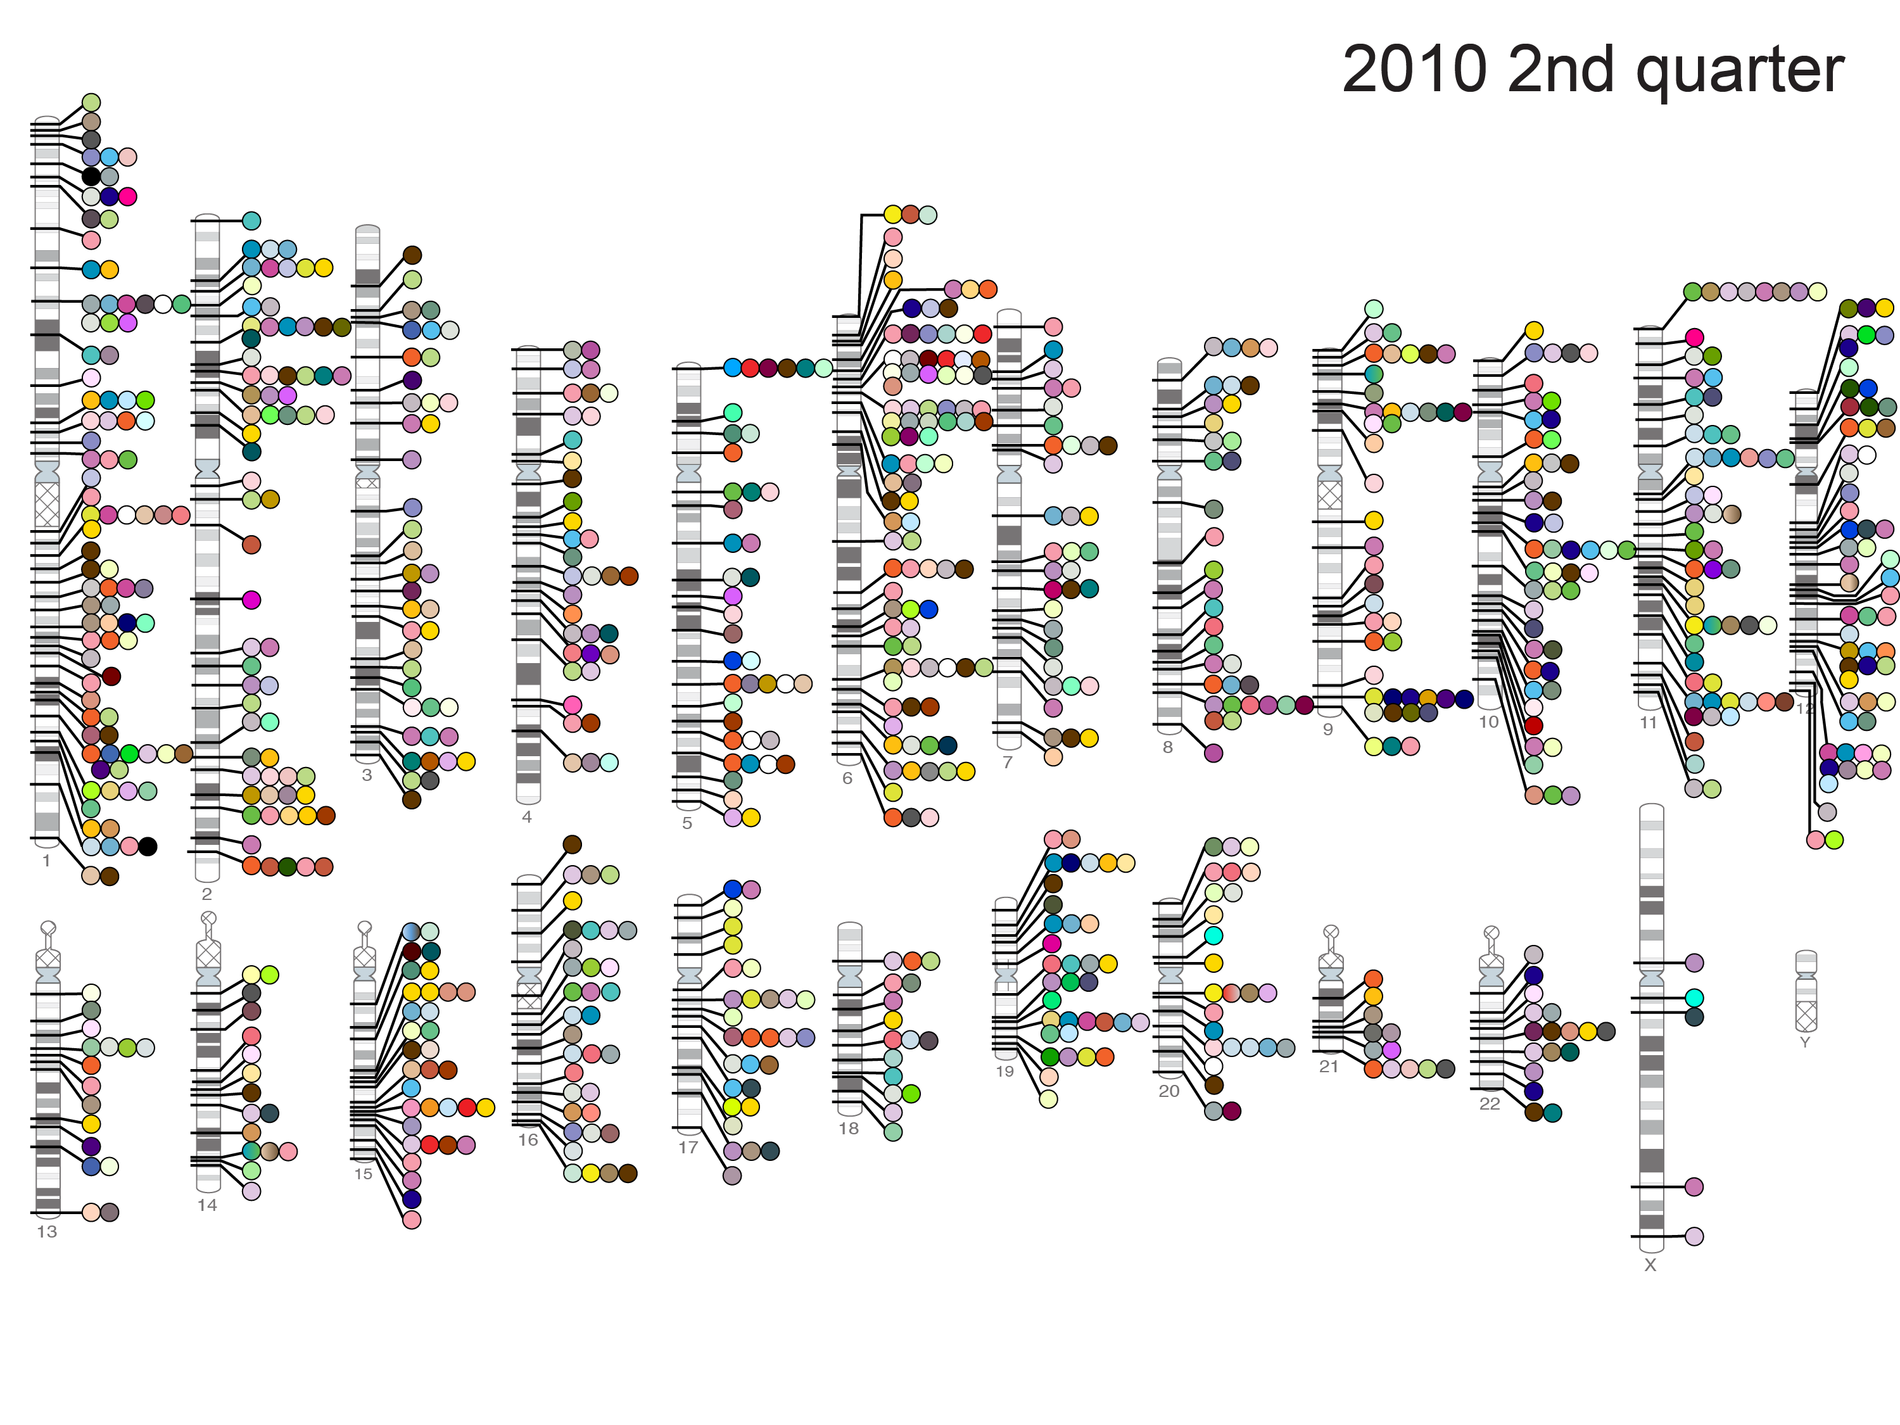
Published Genome-Wide Associations through 6/2010
904 published GWA at p<5x10⁻⁸ for 165 traits
NHGRI GWA Catalog
www.genome.gov/GWAStudies

Slide 41
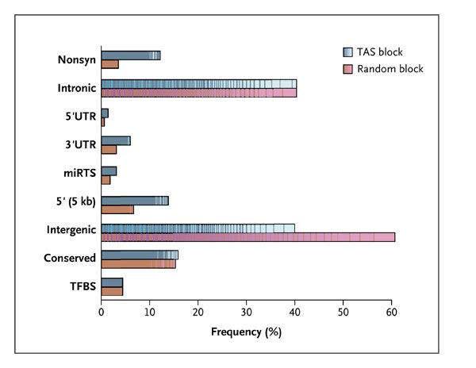
Functional classifications of 465 Trait-Associated SNPs and the SNPs in Linkage Disequilibrium with them
Manolio T. N Engl J Med 2010;363:166-176

Slide 42
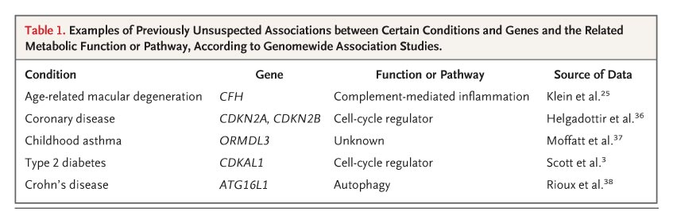

Examples of Previously Unsuspected Associations between Certain Conditions and Genes and the Related Metabolic Function or Pathway, According to Genomewide Association Studies
Manolio T. N Engl J Med 2010;363:166-176

Slide 43
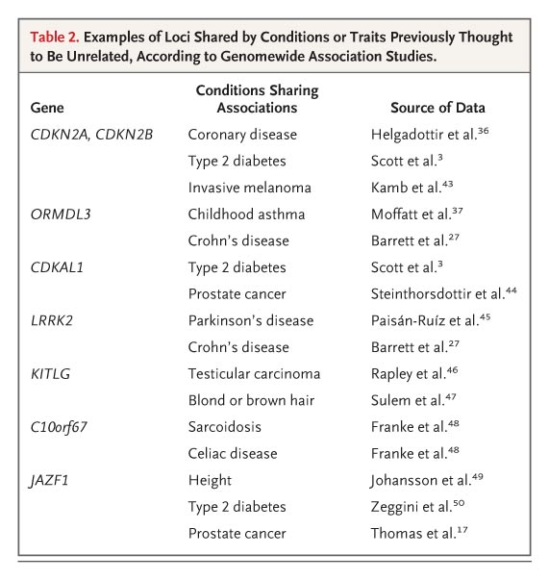
Examples of loci shared by conditions or traits previously thought to be unrelated, according to Genomewide Association Studies
Manolio T. N Engl J Med 2010;363:166-176

Slide 45
Individual genes
[Lango Allen et al. Nature 2010]

Slide 46
GIANT Consortium - Height
180,000 individuals
180 loci identified
Allelic effect sizes 1 to 4 mm
Enriched for genes that are connected in biological pathways that underlie skeletal growth
BUT only ~12% of heritability explained !

Slide 47
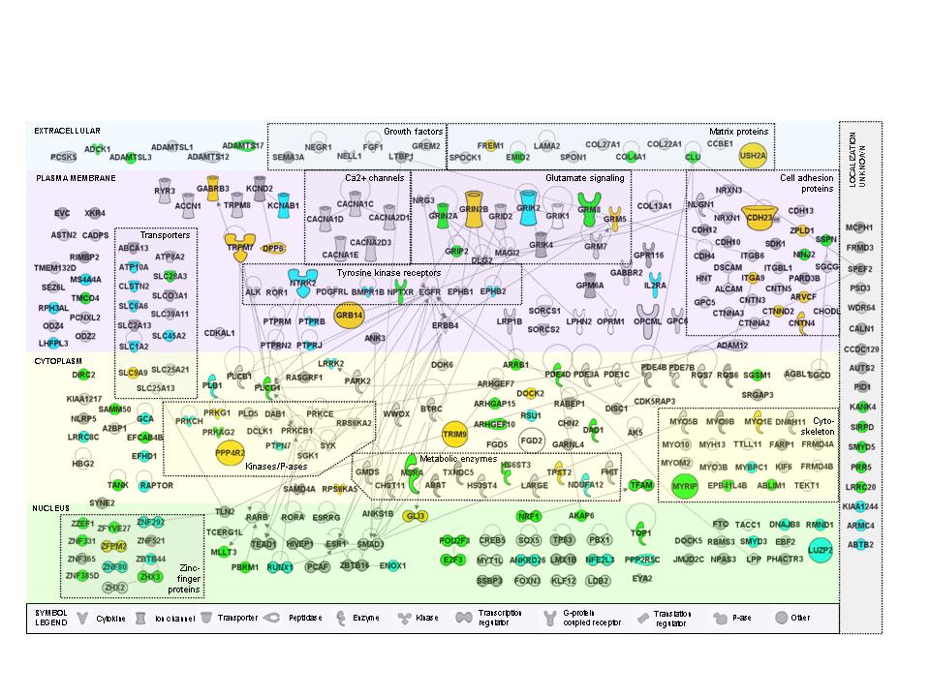
Pathway (Ingenuity) analysis of GWAS for smoking
Vink et al, 2009 AJHG in press

Slide 48
How much variance have
GWAS studies explained?

Slide 49
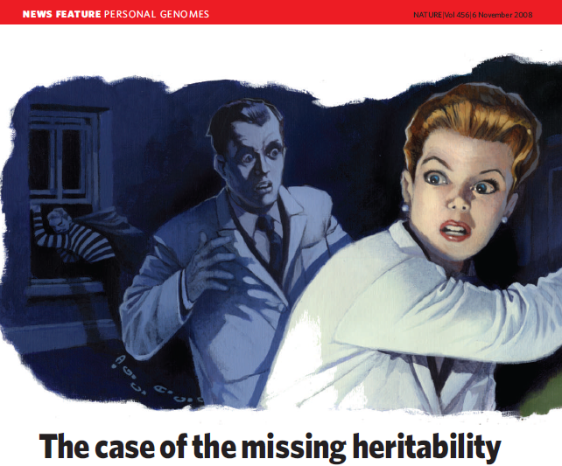
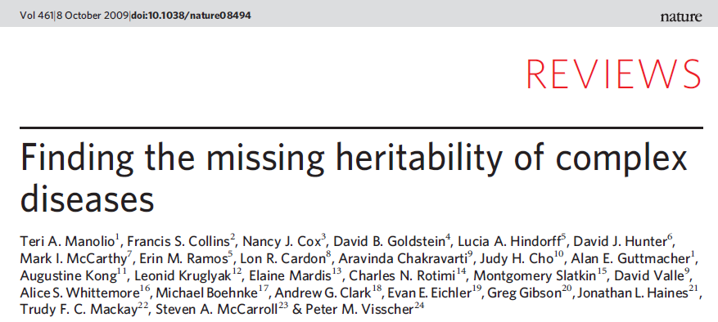
Where is the Dark Matter?

Slide 50
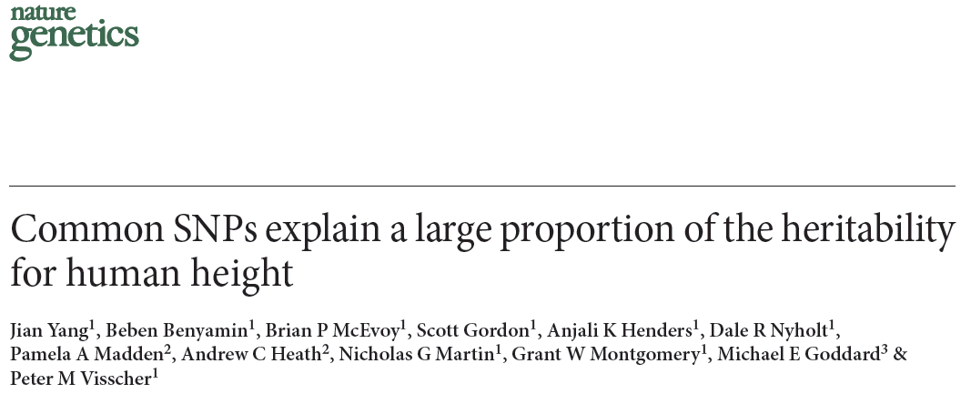
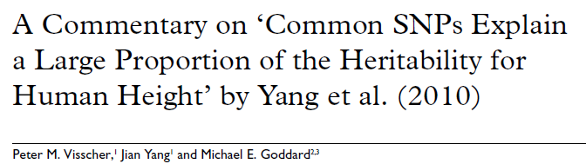

Slide 51
Are very distant relatives that share more of their genome by descent phenotypically more similar than those that share less?
Estimating heritability from ‘unrelated’ individuals

Slide 52
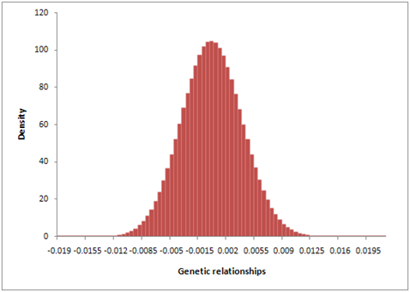
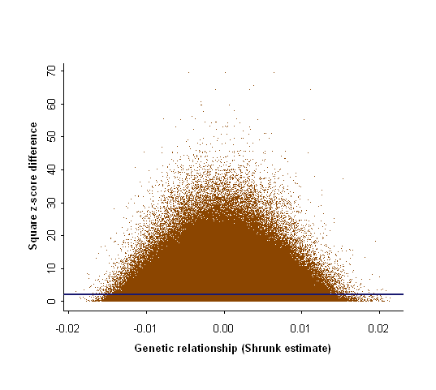
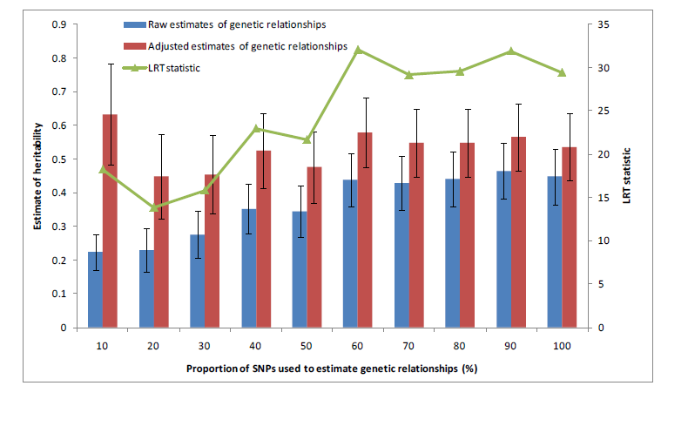
Proportion of variance tagged by SNPs ~ 0.55 (SE 0.1)
[Yang et al. Nature Genetics 2010]

Slide 53
More than 50% of genetic variation is tagged by common SNPs
Evidence that causal variants have lower MAF than genotyped SNPs

Slide 54
Estimates of GW SNP-associated variance ~half that estimated from twin studies ?!
Phenotype | Variance explained by typed SNPs | Additive heritability
MDD | 21.1% | 36%
Smoking initiation | 12.2% | 44%
Current smoking | 42.1% | 79%
Fasting glucose | 25.4% | 53%
Height | 48.2% | 90%
Lubke & Boomsma, submitted , 2011

Slide 55
The White House - June 26, 2000
Venter
Clinton
Collins

Slide 56
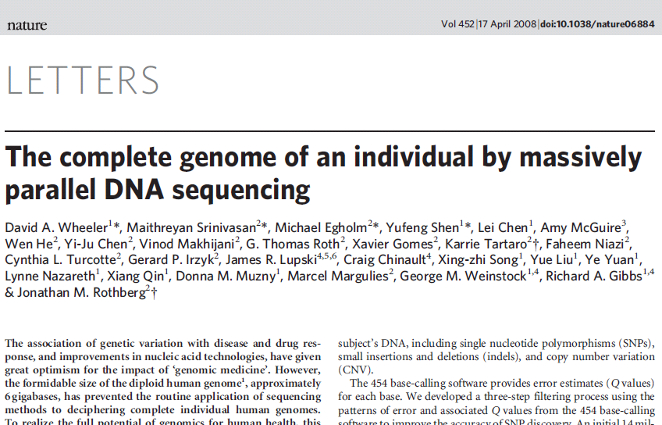
It took 4 months, a handful of scientists and ~ US$1.5 mil to sequence the genome of DNA pioneer James Watson

Slide 57
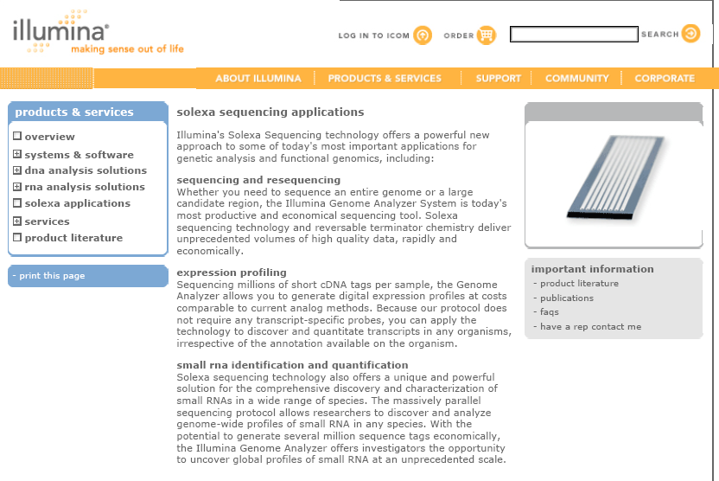
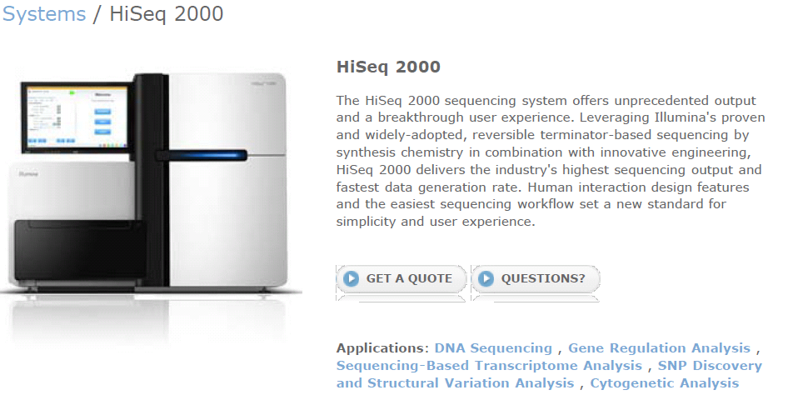

Slide 58
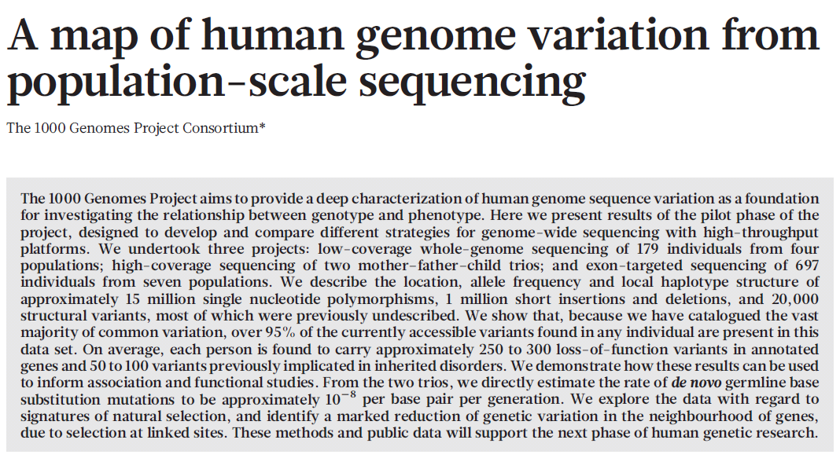

Slide 59
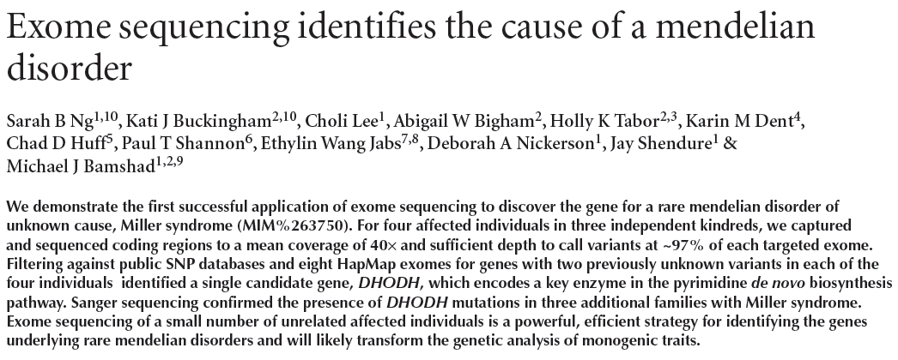
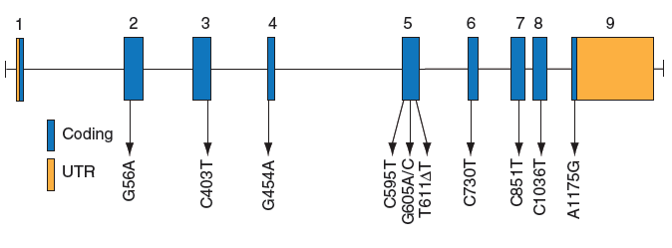

Slide 60
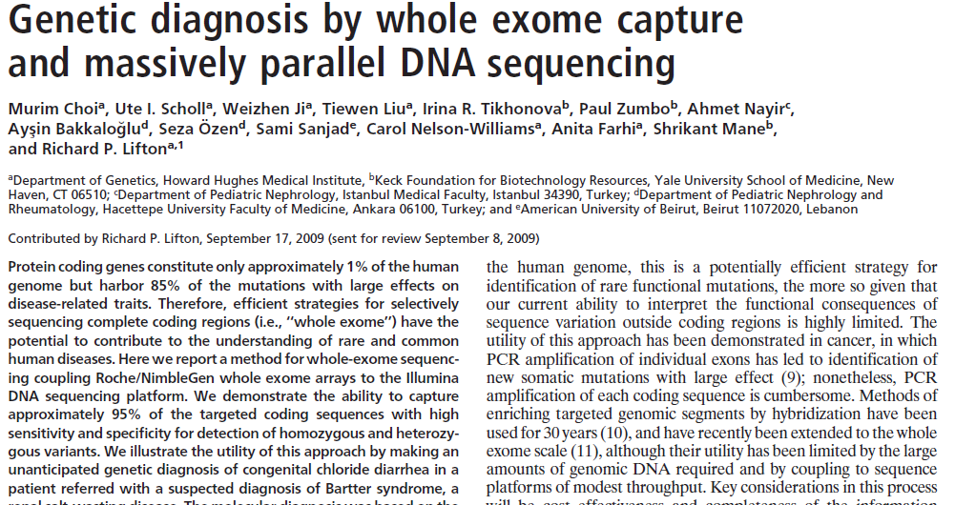
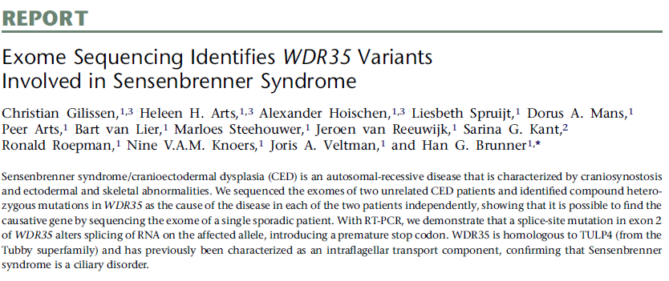
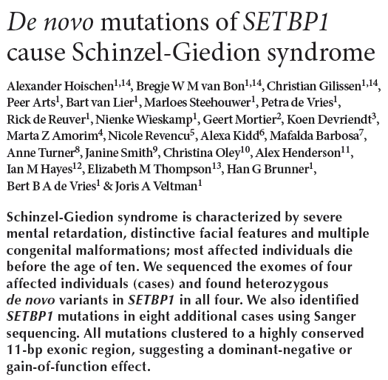

Slide 61
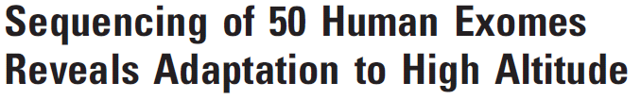
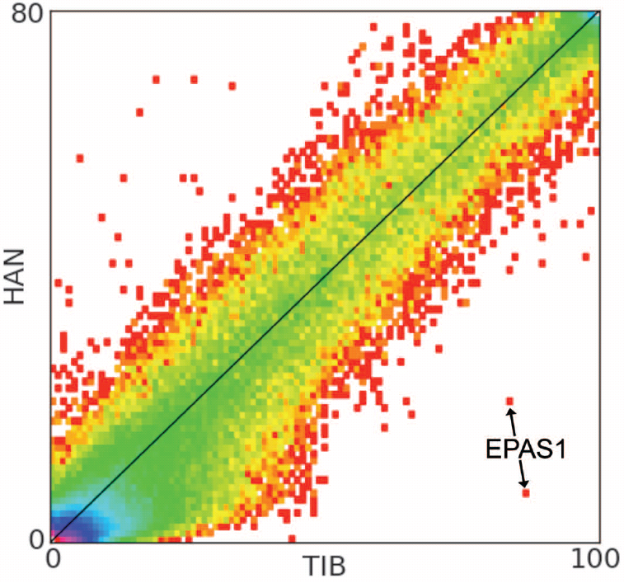
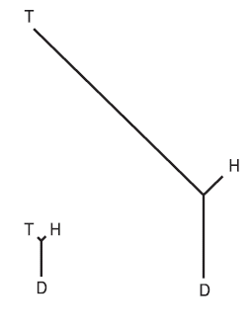
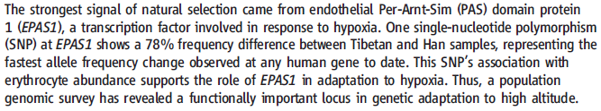
EPAS1
average

Slide 62
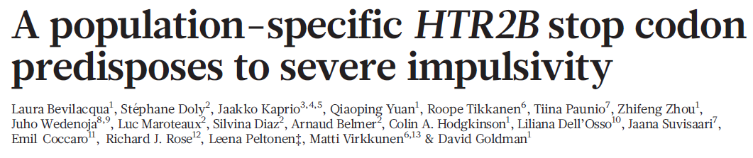
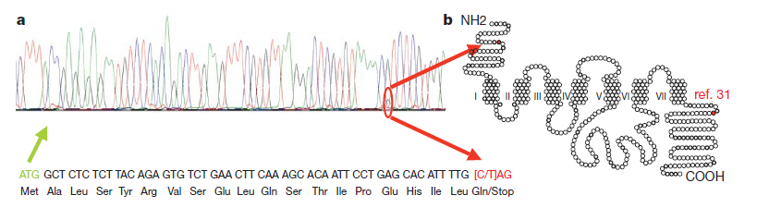

Slide 63
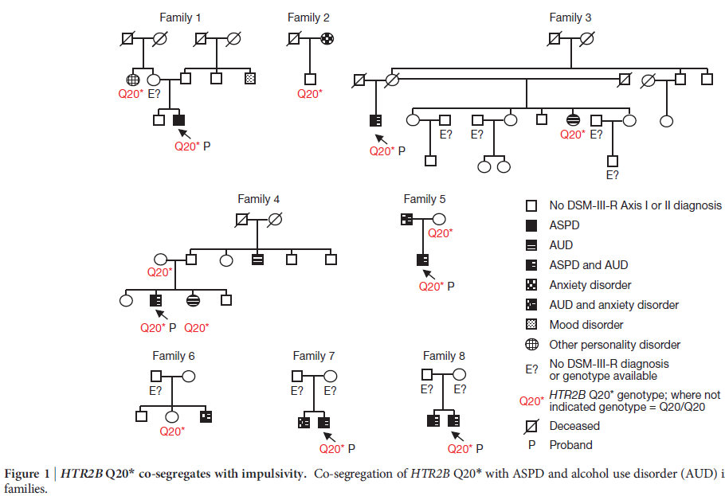

Slide 64



Slide 65

We also run two journals (1)
Editor: John Hewitt
Editorial assistant Christina Hewitt
Publisher: Kluwer /Plenum
Fully online
http://www.bga.org

Slide 66
We also run two journals (2)
Editor: Nick Martin
Editorial assistant + subscriptions: Lorin Grey
Publisher: Australian Academic Press
Fully online
http://www.ists.qimr.edu.au/journal.html

