Slide 1
SO…. Where the helarwe?
Lindon Eaves
Boulder March 2011

Slide 2
Themes
Overview of progress/degeneration in current genetic paradigm
What do we think we know about genetic architecture of complex traits?
What might we need to pay attention to in future?
What further conceptual and technical tools might we need?

Slide 3
1865
Mendel
(particulate inheritance)
Galton (correlation between relatives)
Darwin
(natural selection)
Archibald Garod
R.A. Fisher
Sewall Wright
“Human” Genetics
Oligogenic
“The Double
Helix”
Quantitative Genetics
Polygenic
Population Genetics
Sociobiology
Conflicting Paradigms
“Gene Hunting” (DNA)
“Structural Modeling” (Twins etc.)
2010
FUTURE?

Slide 4
The “Medical Genetic” Paradigm: Progress or Degeneration?
It depends what you were hoping for.
# of genes (k)
Q%~100h²/k
Decade
Approach
Segregation analysis
1 or 2?
1980
1990
Linkage
4 or 5?
2000
GWAS
100’s? 1000’s?
2010
Sequencing
????
????
Epigenetics? Epistasis? GxE? Heterogeneity?

Slide 5
Converging paradigms?
We have learned a lot, but not (yet?) what the patrons thought they were paying for.
“Reality cannot be fooled”
[Richard Feynman]

Slide 6
Implications:
Human variation/disease is not likely to yield to studies of one or two genes, one or two environments, or one intersection of these.
“Fact is preferable to artifact – but takes longer to find and is harder to publish.”

Slide 7
The “medical genetic” (oligogenic) paradigm does not explain as much as its early advocates had claimed/hoped BUT is supporting key elements of the “quantitative genetic” paradigm the point where it needs to have greater influence in the way we think and function about complex human diseases and traits.

Slide 8
Lessons from Biometrical Genetics
Plants, flies, fungi, bacteria, rodents: randomized, cross-classified, balanced, inbreeding/crossing/selecting
If you can measure it, you will find genes affect it.
“Heritability” doesn’t tell you much about biology
Large number of genes of small effects
Genes all over genome (“chromosome assay”, c.f. GCTA)
Substantial environmental components (not just random, individual Es bigger than individual genes)
Genes create environment (rGE) of self and others (maternal effects, competition).
Genetic and environmental effects change in response to changing adaptive demands of development (GxAge)
Sensitivity to the environment an important quantitative phenotype (GxE, general and specific)
Some polygenic epistasis: multiple types depending on adaptive “needs” of system (e.g. duplicate and complementary)
Interactions are found but, typically don’t explain a lot relative to main effects
Epigenetic effects important (“induced heritable changes”)
Gene expression (e.g. “dominance”) modified by selection
Can help jump-start and prioritize areas of inquiry at lower cost.
“The number of genes is directly proportional to the industry of the investigator”
(J.L. Jinks, c.1977).

Slide 9
From Genes to Behavior: A Developmental Perspective
Pre- and Peri-Natal
Culture, Media, Parents,
Siblings, Peers,
Teachers, Infection
Accidents, Life events, Habits,
Life-styles, SES
Environment
Population structure
Stratification
Admixture
Ethnicity
DNA
Epi-Genetics
Brain
Behavior
Expression
Methylation
CNVs
Metabolites
Proteins
Achievement
Adaptation
Social/Anti-social
Drugs
Depression Anxiety
Suicide
Etc……
Markers
SNPs
Candidate genes
“Imaging”
DEVELOPMENT

Slide 10
Measured Genotypes
Measured Environments
G₁
G₂
G₃
G₄
E₁
E₂
E₃
E₄
G’₄
G’₁
Endophenotypes
P₁
T
I
ME
?
P₂
P₃
P₄
E’₁
G’₂
E’₃
E’₄
P₅
E’
E
G
P
G’₅
Outcome Phenotype

Slide 11
Interaction: [Genetic?] variation in network pathways
A
β~N[μ_{β} ,σ²_{β}]
B

Slide 12
“Epistatis” Interaction between genes
“Parallel”
“Series”
A
A
B
B
C
C
X
X
“Duplicate Genes”
15:1 in F₂
“Redundant pathways”
“Complementary Genes”
9:7 in F₂

Slide 13
Combining pathways
Complementary Genes
Phenotypic
Response
Additive
Duplicate Genes
Dose of Bad Alleles

Slide 14
Putting the “Human” back in the equation

Slide 15
Extending the Phenotype
World
Parents
Me
Spouse
Siblings
Child
Extended Phenotype

Slide 16
Changing models of discovery:
Theory-driven (“supervised learning”, “real science”) e.g. testing Mendelian segregation ratios; candidate gene associations.
Exploratory (“unsupervised learning”, “data mining”, “data-grubbing”,”fishing expedition”,”crass empiricism”) e.g. GWAS.
Probably need elements of both – variable priors – include prior information to constrain search (e.g. gene networks,INRICH..).
“An erroneous assumption of ignorance is not innocuous” (R.A. Fisher “Design of Experiments”)

Slide 17
The next generation
Multilayered: genome; environments; “epigenetic” systems; “endophenotypes”; complex (multivariate) outcomes
Hugh (?vast) dimensionality
Highly networked
Identification of causal systems and critical intervention points (may not be “DNA”).

Slide 18
The silent partner
Computer power

Slide 19
E.g. 5-variable “ACE” model
1977 Eng. Elec. KDF-9 mainframe, 240K, ¼ acre; FORTRAN 4: 11 hours
2011 Dell XPS laptop, 3GB, 1½ ft²
Mx: <1 sec.
Examples all over the place (e.g. PLINK: speed and storage)

Slide 20
Computer intensive methods
Resampling methods (permutation, bootstrap etc.)
Simulation
MCMC, model selection.
Data mining; Artificial Intelligence;
Neural networks; recursive partioning; Bayesian networks; CART; MARS; random forests…etc. Etc.
Have informative “bits” of our puzzle, but not yet systematic algorithms.

Slide 21
Recovering Causal Networks From Correlational Data

Slide 22
“Not pretty…
…but seems to work”
Totally unsupervised…

Slide 23
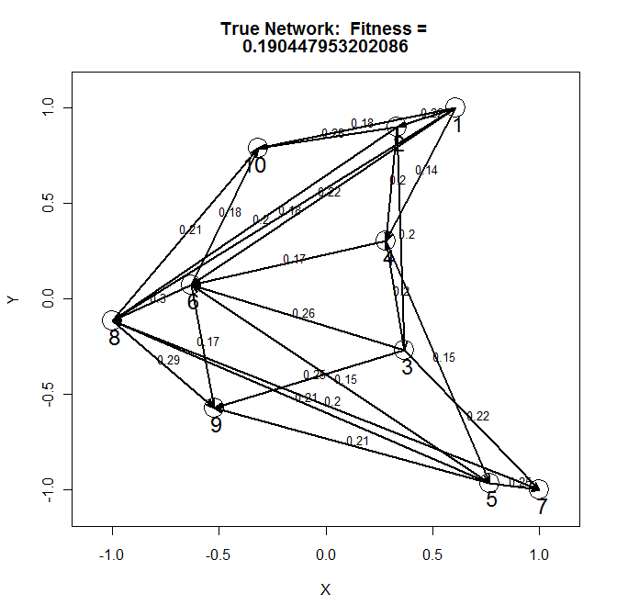
Example “Network”

Slide 24
Matrix representation of network
From:
B
[,1] [,2] [,3] [,4] [,5] [,6] [,7] [,8] [,9] [,10]
[1,] 0.00 0.00 0.00 0.00 0.00 0.00 0.0 0.00 0 0
[2,] 0.22 0.00 0.00 0.00 0.00 0.00 0.0 0.00 0 0
[3,] 0.00 0.20 0.00 0.00 0.00 0.00 0.0 0.00 0 0
[4,] 0.14 0.20 0.20 0.00 0.00 0.00 0.0 0.00 0 0
[5,] 0.00 0.00 0.00 0.15 0.00 0.00 0.0 0.00 0 0
[6,] 0.22 0.00 0.26 0.17 0.15 0.00 0.0 0.00 0 0
[7,] 0.00 0.00 0.22 0.00 0.25 0.00 0.0 0.00 0 0
[8,] 0.18 0.20 0.00 0.00 0.21 0.30 0.2 0.00 0 0
[9,] 0.00 0.00 0.25 0.00 0.21 0.17 0.0 0.29 0 0
[10,]0.18 0.28 0.00 0.00 0.00 0.18 0.0 0.21 0 0
To:
Σ=(I-B)⁻¹ Ω(I-B)’⁻¹

Slide 25
Note:
This simple model assumes no individual differences in the β’s
i.e. “additive model”
β’s may vary genetically (GxE, epistasis)

Slide 26
Stick with additive model for now:
Nodes vary between people but β’s don’t,

Slide 27
Correlation Matrix Produced by Network
[,1] [,2] [,3] [,4] [,5] [,6] [,7] [,8] [,9] [,10]
[1,] 1.00000000 0.21486178 0.04310545 0.18098924 0.02855772 0.2421054 0.01598732 0.2642392 0.1284700 0.30381860
[2,] 0.21486178 1.00000000 0.20061942 0.25892353 0.04085473 0.1384803 0.05237286 0.2602729 0.1467666 0.35682576
[3,] 0.04310545 0.20061942 1.00000000 0.23587620 0.03721817 0.2914129 0.22122078 0.1687392 0.3142624 0.14134859
[4,] 0.18098924 0.25892353 0.23587620 1.00000000 0.15778687 0.2771978 0.08784687 0.1935244 0.1776897 0.17966427
[5,] 0.02855772 0.04085473 0.03721817 0.15778687 1.00000000 0.1772714 0.24725920 0.2839686 0.2952557 0.10510441
[6,] 0.24210536 0.13848029 0.29141291 0.27719779 0.17727140 1.0000000 0.10430176 0.3908405 0.3636515 0.32481968
[7,] 0.01598732 0.05237286 0.22122078 0.08784687 0.24725920 0.1043018 1.00000000 0.2629063 0.1831995 0.08906656
[8,] 0.26423919 0.26027293 0.16873924 0.19352445 0.28396860 0.3908405 0.26290631 1.0000000 0.4358697 0.38397976
[9,] 0.12846997 0.14676658 0.31426238 0.17768974 0.29525571 0.3636515 0.18319951 0.4358697 1.0000000 0.21051176
[10,]0.30381860 0.35682576 0.14134859 0.17966427 0.10510441 0.3248197 0.08906656 0.3839798 0.2105118 1.00000000

Slide 28
Question
How do we recover network from correlation matrix?

Slide 29
Assume
No extrinsic correlation – i.e. correlations between variables due entirely to network
or Ω=I
Network is acyclic (no “loops” or reciprocal effects) i.e. B is lower triangular with zero diagonal for given permutation of rows and columns of Σ.
“Aye, there’s the rub”

Slide 30
One Network (k=4)
1
λ₂₁
2
λ₄₂
λ₄₁
λ₃₁
λ₃₂
4
λ₄₃
3
Yellow -> Green; Blue; Pink
Green-> Blue; Pink
Blue -> Pink
4 variables, 6 arrows

Slide 31
Another Network (k=4)
1
2
λ₂₁
λ₄₂
λ₄₁
λ₃₁
λ₃₂
4
3
λ₄₃
Blue -> Yellow; Pink; Green
Yellow-> Pink; Green
Pink-> Green
4 variables, 6 arrows

Slide 32
And so on
k! orders of variables, each with ½k(k-1) arrows
Can show that any order can be made to fit correlations equally well (by fudging the β’s in network diagram) unless have some way of reducing complexity of model (“dropping arrows that are not important”) and choosing between models (“fitness”).

Slide 33
One approach
Take every possible order (k!) and then drop individual arrows and see how likelihood changes. Pick “simplest model that fits” (penalize high likelihood for model complexity c.f. AIC).
Easy with small k but a pain as k gets bigger:
k=4 k!=24
k=10; k!=3.6x10⁶
k=20; k!=2.4x10¹⁸

Slide 34
Possible alternative
Sample possible orders
Compute B.
Drop unimportant arrows
Score each for “fit” : small discrepancies with relatively few parameters
Pick the best B or best set of possible Bs.

Slide 35
“Fitness”
TSS is the sum of squares of the off-diagonal elements of the original correlation matrix (i.e. what has to be explained)
Fit<-sum((R[obs]-R[hat])^2)/2
Gain<-(TSS-Fit)/(npar[+negpar?])

Slide 36
Try it Sample 2,500 from 10!

Slide 37
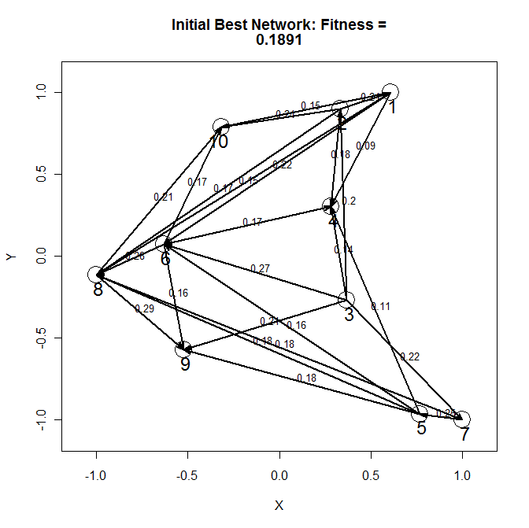
Not bad guess, but some arrows “flipped” (4->5; 4->6)

Slide 38
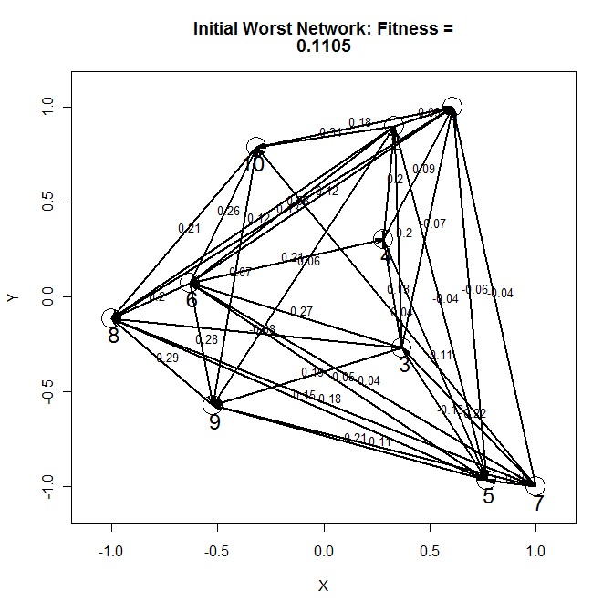
Bloody mess: arrows everywhere

Slide 39
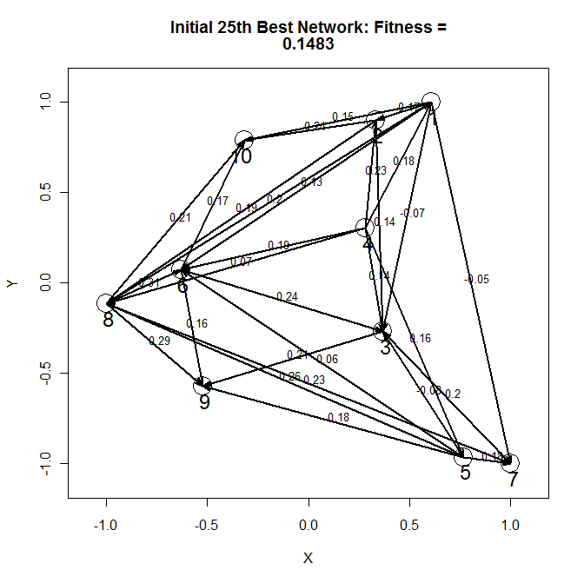
Better than “worst” but more complex than “best” and arrows flipped

Slide 40
Problem…
…Covers only a small fraction of possibilities. Likely to miss most of them when k large

Slide 41
Can we do better without computing and comparing all k! orders?
Learn from evolution: the genetic theory of natural selection

Slide 42
Evolutionary (“Genetic”) Algorithm
Initial population
(Sample) of models
“Mutate and reproduce”
Mutate
Next population of models (parents)
Progeny models
“Enrichment”
“Select fittest”

Slide 43
Example
Start with random sample of orders (N=2500)
Evaluate fitness
Pick “best” 25 as parents
Mutate by shuffling order to produce 100 progeny per parent
Evaluate fitness of new progeny (N=25 x 100)
Pick best 25 as parents of next generation
Repeat for (say) 20 generations
Implement in R
Note: if it works we will find “best” (or set of “best”) networks after 20x2500<<10! tests.

Slide 44
“Mutation” (“Chromosome Inversion”)
Random break point
Parent Order
1 - 2 - 3 - 4 - 5 - 6 - 7 - 8 - 9 - 10
“Flip”
1 - 2 - 3 - 4 - 10 - 9 - 8 -7 - 6 - 5
Offspring Order

Slide 45
Results
After 20 generations of selection

Slide 48
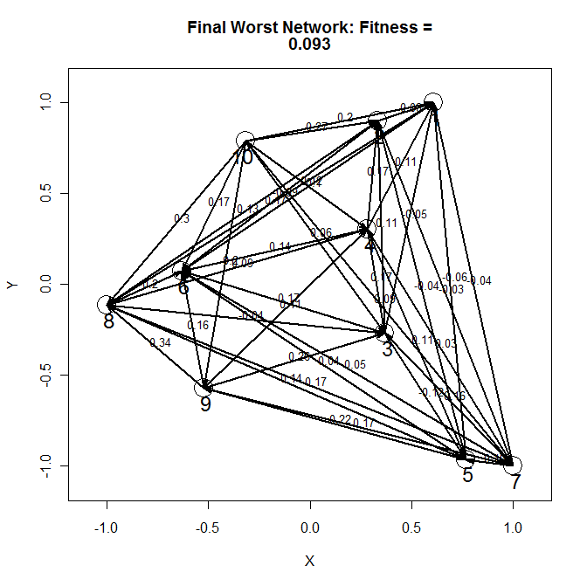

Slide 49
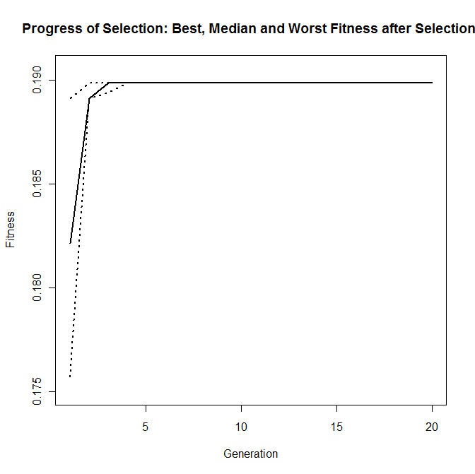
i.e. Top 25 all compare well with “truth”

Slide 51
An ‘orrible example
k=20
k!=2.4329x10¹⁸

Slide 52
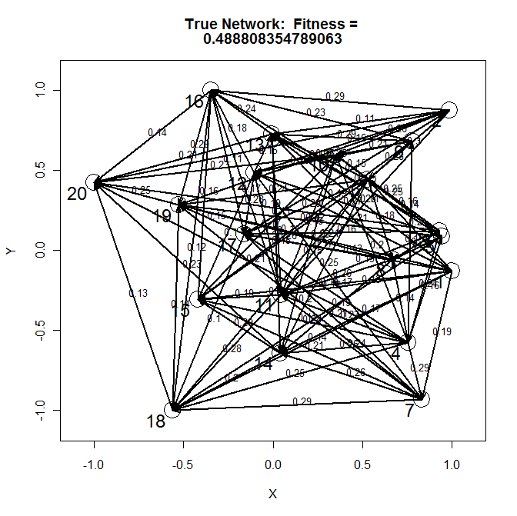

Slide 53
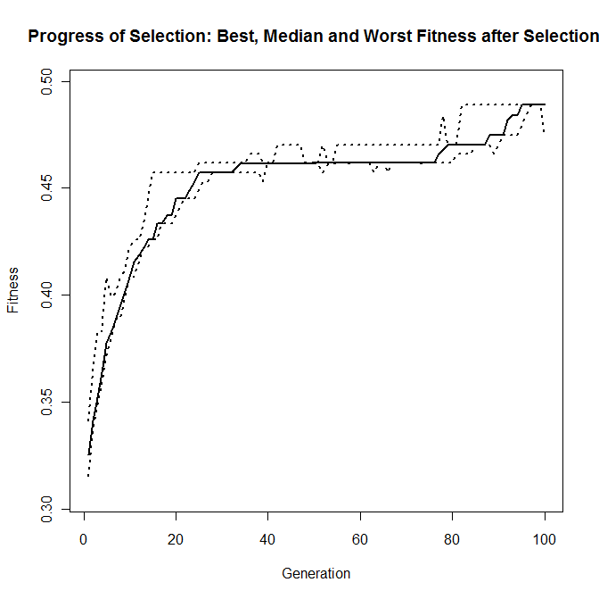

Slide 54
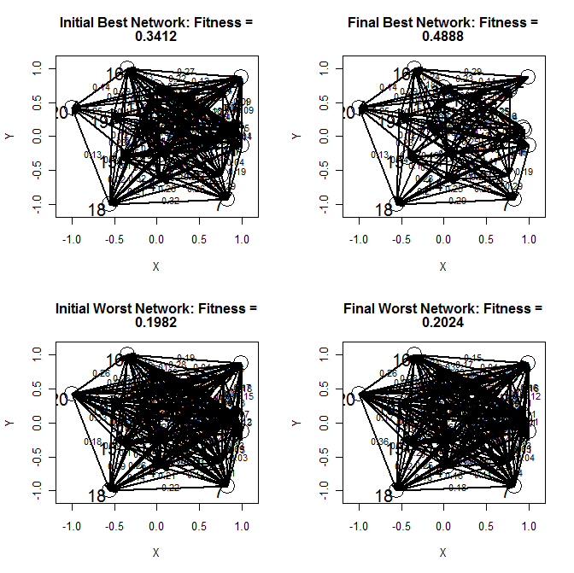

Slide 55
[Almost] The Last Word
More variables
More people
New algorithms
More money

Slide 56
The shape of things to come:
“Elementary, my dear Watson.”
http://en.wikipedia.org/wiki/Watson_(artificial_intelligence_software)
http://www-03.ibm.com/innovation/us/watson/?cn=agus_watson-20100712&cm=k&csr=google&cr=watson_jeopardy&ct=USJWK002&S_TACT=USJWK002&ck=watson_jeopardy&cmp=00000&mkwid=sYgdrUCPT_9199313973_432n0d3749

Slide 57
[Really] The Last Word
Evangelist at molecular geneticist’s front door (c.1970):
“Scientists haven’t yet found the key to the meaning of life.”
Geneticist:
“No. But we are working on it.”
:=)

