Slide 1
Likelihood Practical
Likelihood
Revise
Fits?
paper
Theory
Model
Data
Expected stats
Means, Var-Cov, etc
Parameters
For ACE model: a, c, e etc
Mx, etc
Slightly modified from Lindon Eaves

Slide 2
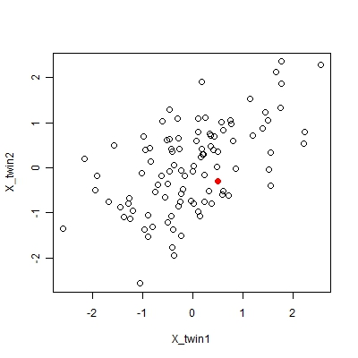
Likelihood Practical - idea
X_tw1 | X_tw2 | Likelihood
-1.25 | -1.12 | 0.071
-0.94 | 0.39 | 0.072
0.25 | 1.12 | 0.092
-0.03 | -0.73 | 0.131
0.5 | -0.3 | 0.133
-1.58 | 0.5 | 0.017
... | ... | ...
Overall Likelihood: |  | 250.230
Overall -2LogL: |  | -11.045
(1) M = [mean(X_tw1) mean(X_tw2)]
(2) S = var(X_tw1)
cov(X_tw1, X_tw2) var(X_tw2)
L = inv( sqrt( det(2*π*S) ) ) * e ( -0.5 * (X-M) * inv(S) * t(X-M) )

Slide 3
Likelihood Practical - results
Change to R
copy F:\manuel\likelihood\likelihood.R
Into a folder in your H drive

Slide 4
Likelihood Practical - results
Group | X_tw1 | X_tw2 | cov(X_tw1,X_tw2) | Likelihood
1 | 0.5 | -0.5 | -0.5 | 0.1556
2 | 0.5 | -0.5 | -0.25 | 0.1346
3 | 0.5 | -0.5 | 0 | 0.1240
4 | 0.5 | -0.5 | 0.25 | 0.1178
5 | 0.5 | -0.5 | 0.5 | 0.1115
6 | 0.5 | 0.5 | -0.5 | 0.1115
7 | 0.5 | 0.5 | -0.25 | 0.1178
8 | 0.5 | 0.5 | 0 | 0.1240
9 | 0.5 | 0.5 | 0.25 | 0.1346
10 | 0.5 | 0.5 | 0.5 | 0.1556

Slide 5
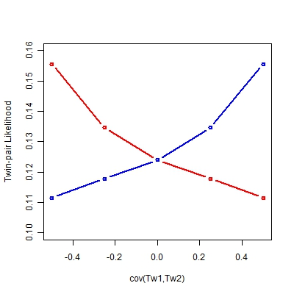
Likelihood Practical - results
X = [0.5 0.5]
X = [0.5 -0.5]

