Slide 1
The Causes of Variation
Twin Methodology Workshop
Boulder,
March 2010

Slide 2
Don’t Panic!

Slide 3
Pretest

Slide 4
Name the Following People

Slide 5
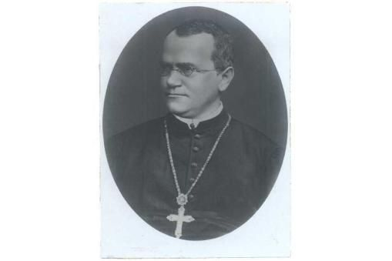

Slide 6
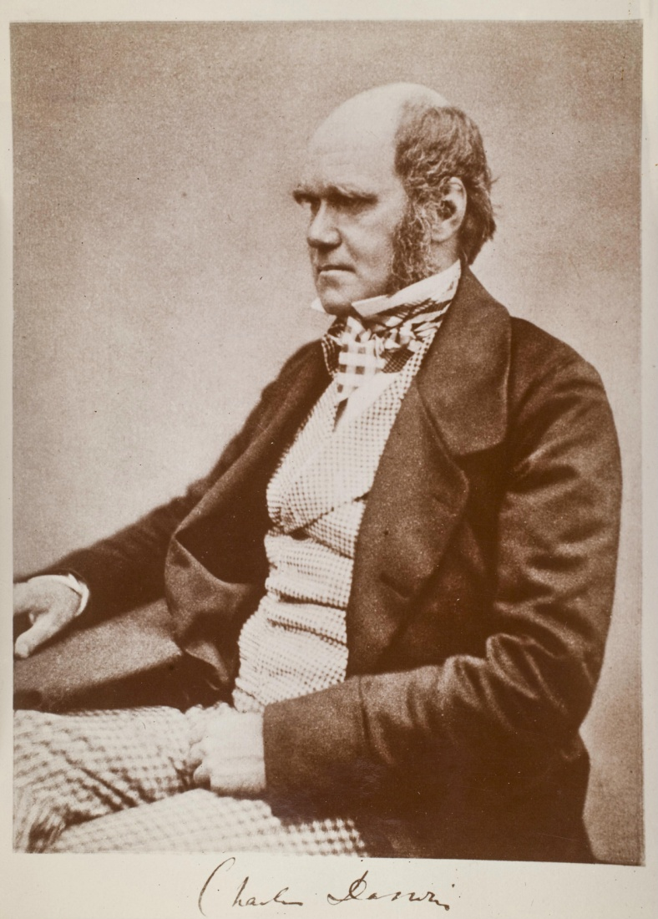

Slide 7
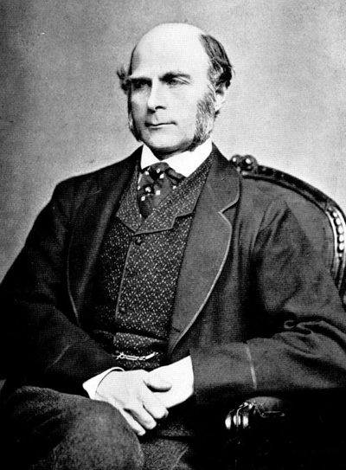
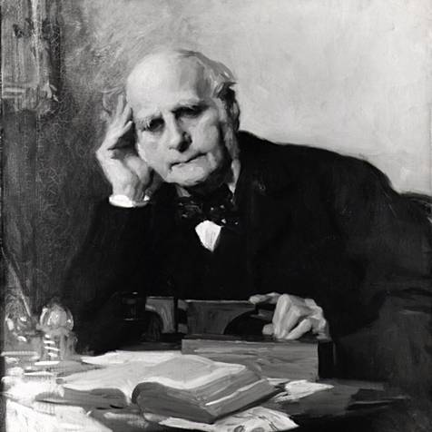

Slide 8
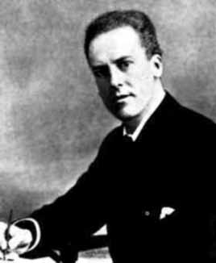
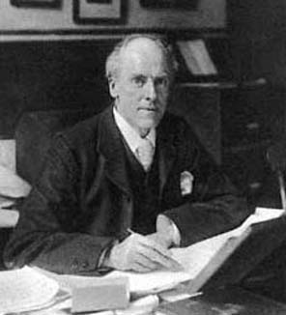

Slide 9
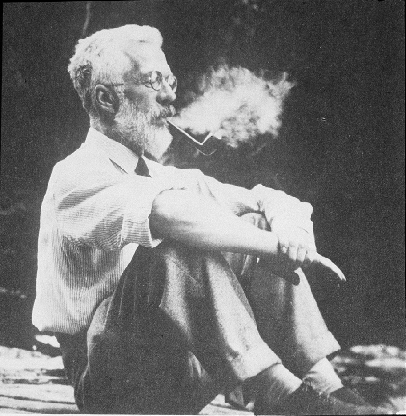

Slide 10
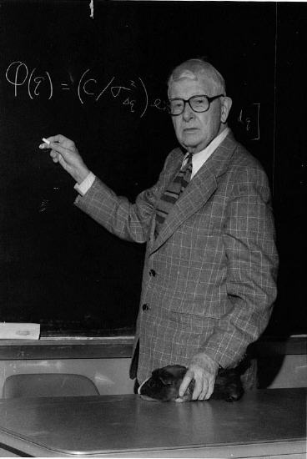

Slide 11
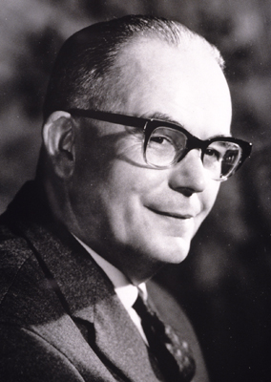
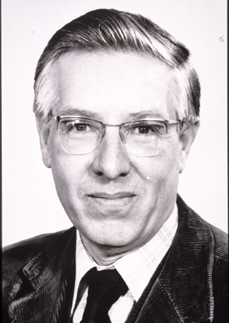

Slide 12
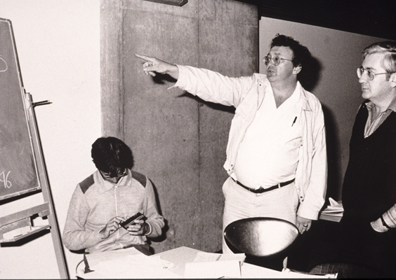

Slide 13
Extra Credit:
What is the guy in the middle pointing to?
What is he saying?

Slide 14
“Genetics”
The Study of
Variation and Heredity

Slide 15
“Variation”
“Why aren’t we all the same?”

Slide 16
“Heredity”
“Why do things run in families?”

Slide 17
“VARIATION”

Slide 18
Continuous variation

Slide 19
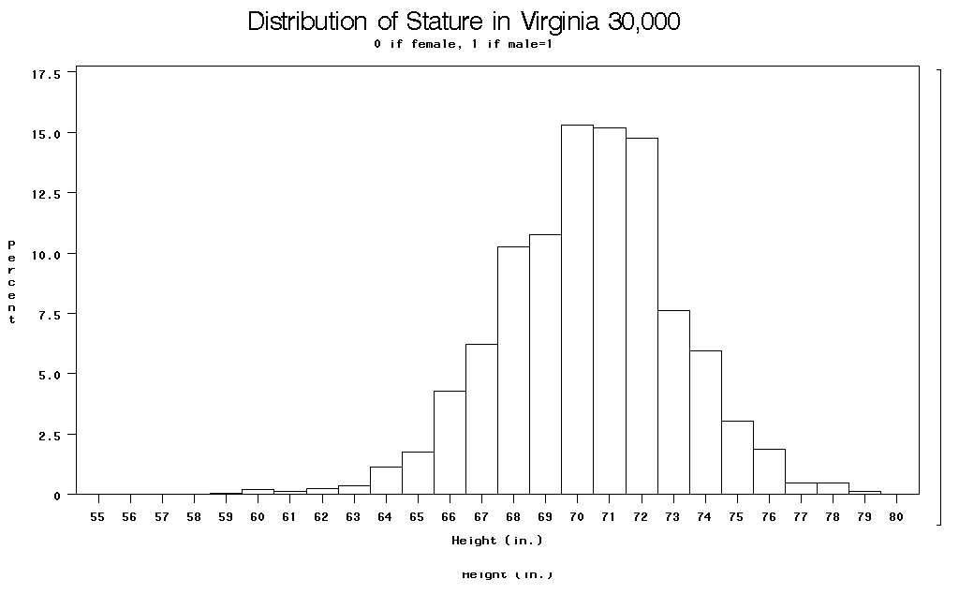

Slide 20
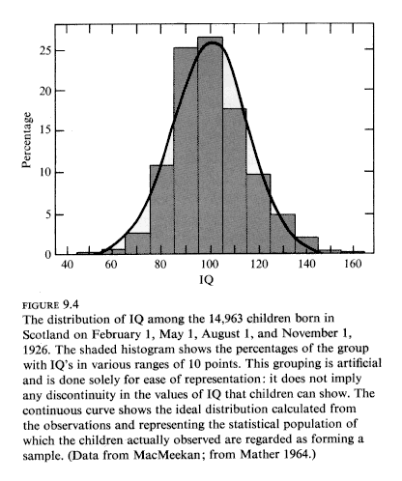

Slide 21
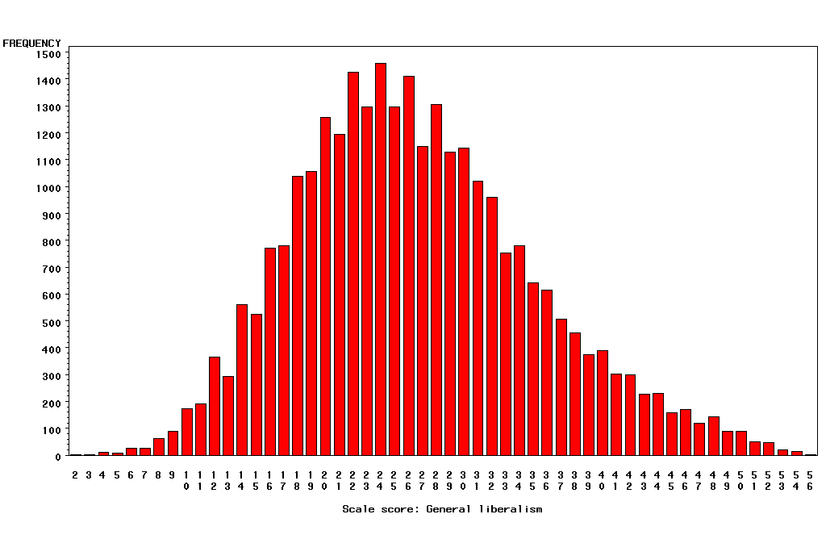
“Liberalism”

Slide 22
Categorical Outcomes
Often called “threshold traits” because people “affected” if they fall above some level (“threshold”) of a measured or hypothesized continuous trait.

Slide 23
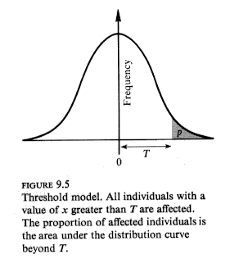

Slide 24
∞
Relationship between continuous normal “liability”
and risk of “diagnosis”
Probability
of
Diagnosis
1
0.5
0
-∞
0
t
+∞
Liability
(Trait Value)
Notes:
Consider e.g. “hypertension”: liability is blood pressure (contininous measure); diagnosis is doctor deciding you are “hypertension”.
Also, e.g. “diabetes” and “fasting glucose”; “republican” and “conservatism”. “Genius” and “IQ”. Etc.

Slide 25
“Heredity”

Slide 26
Charles Darwin (1809-1882)
1865: On the Origin of Species

Slide 27
Francis Galton (1822-1911)
1869: Hereditary Genius
1883: Inquiries into Human Faculty and its Development
1884-5: Anthropometic Laboratory at “National Health Exhibition”
Notes:
Astonishing intellectual curiosity: 3-volume biography by his graduate student (Karl Pearson). Self-styled “gentleman”
i.e. didn’t need to earn his living. Could afford to do research. Many interests: numbers (devised vest with grid of pockets to accumulate contingency table from observations); finger-prints; composite photographs; family history (pedigree methods); statistics (devised correlation coefficient);
Measured family resemblance; collected first “twin” data (though Augustine hit on the method in the 4th Cent. Ch. 5 of Civitas Dei.)

Slide 28
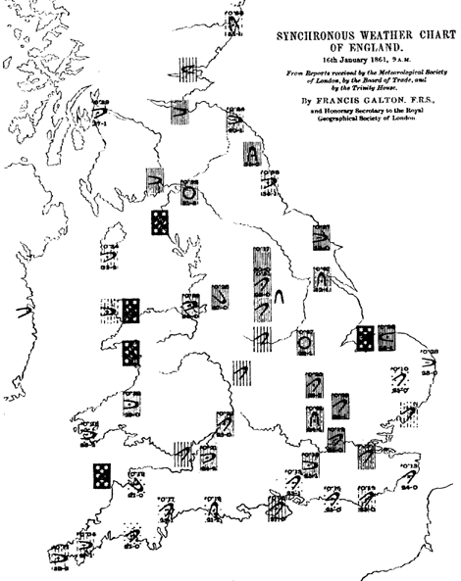
Galton’s Other Work e.g. Meteorology

Slide 29
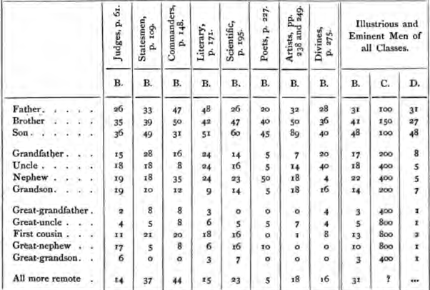
Hereditary Genius (1869, p 317)

Slide 30
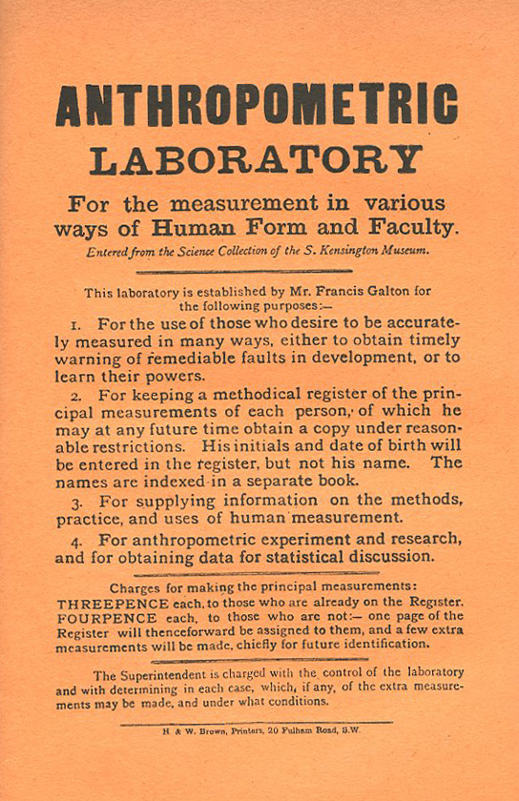
Galton’s Anthropometric Laboratory:

Slide 31
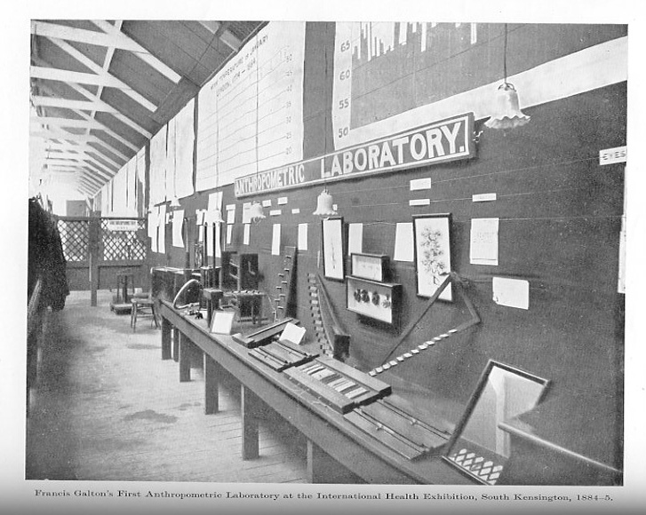

Slide 32
Karl Pearson (1857-1936)
1903: On the Laws of Inheritance in Man: I Physical Characteristics (with Alice Lee)
1904: II Mental and Moral Characteristics
1914: The Life, Letters and Labours of Francis Galton

Slide 33
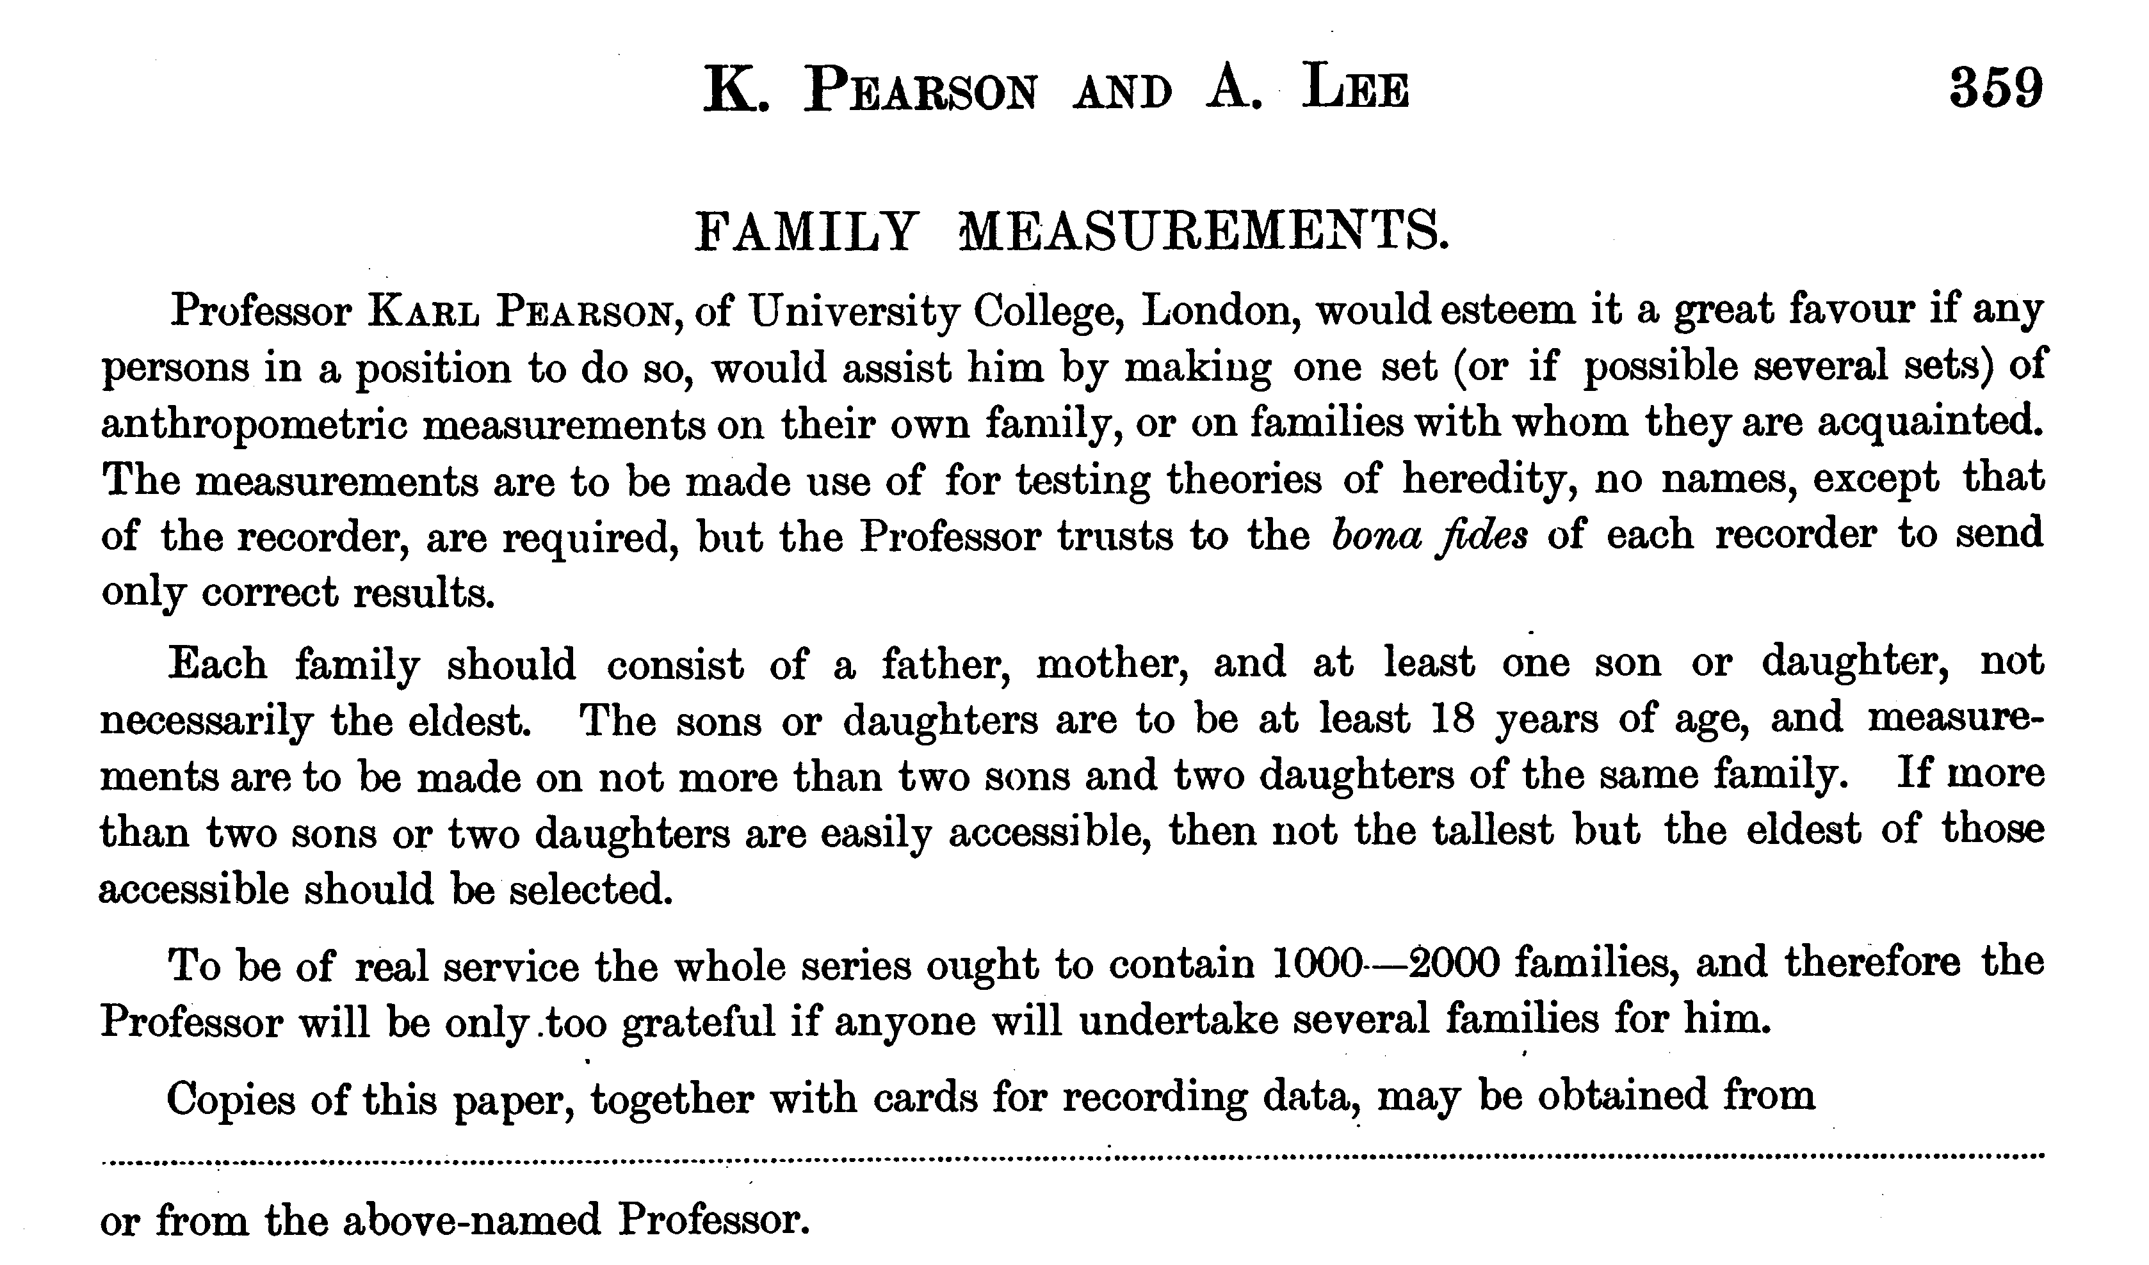

Slide 34
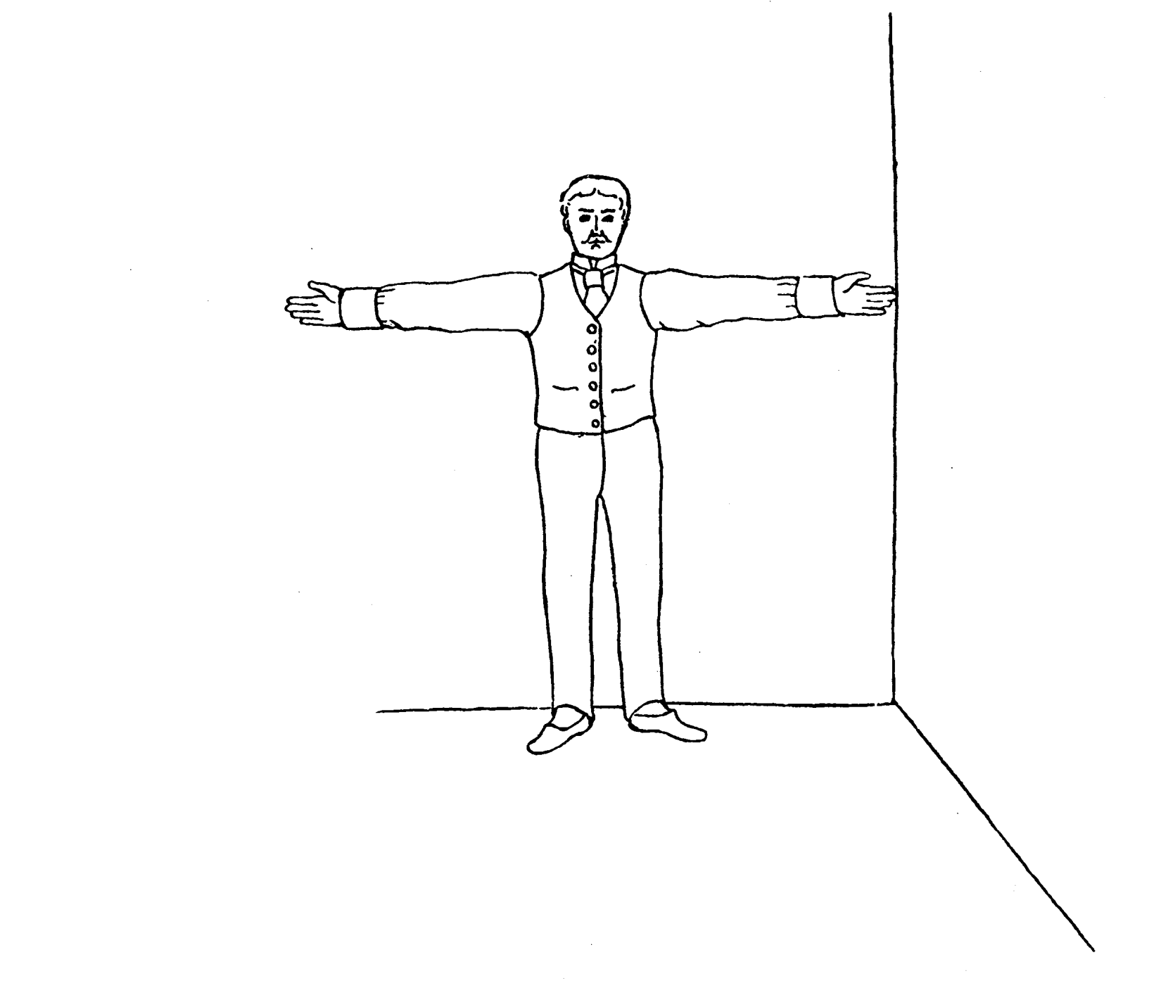
Pearson and Lee’s diagram for measurement of “span” (finger-tip to finger-tip distance)

Slide 35
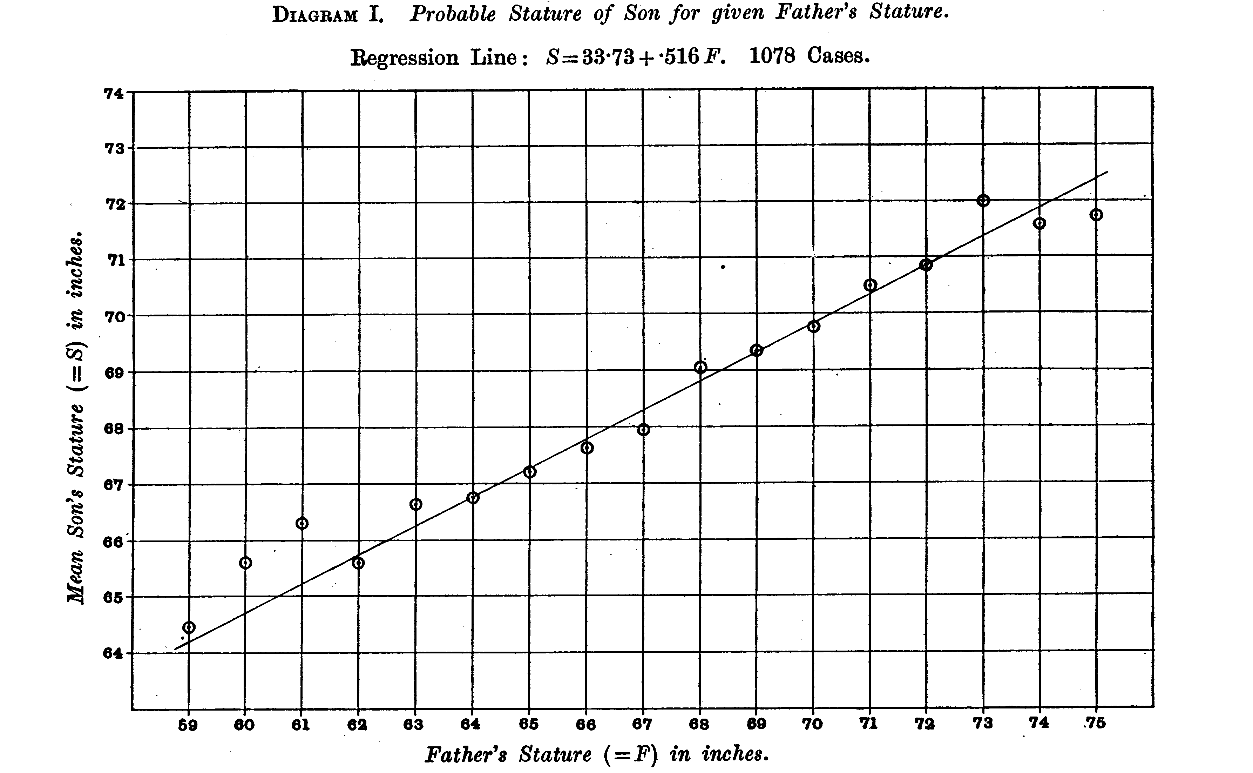
From Pearson and Lee (1903) p.378
Notes:
Notice “Regression to mean”
i.e. Extreme fathers produce son’s who are different from mean in same direction but not as extreme
This happens because fathers only account for part of the differences among their sons – the effects of the mother and random
effects of the environment “dilute” the effects of the father (and vice-versa).

Slide 36
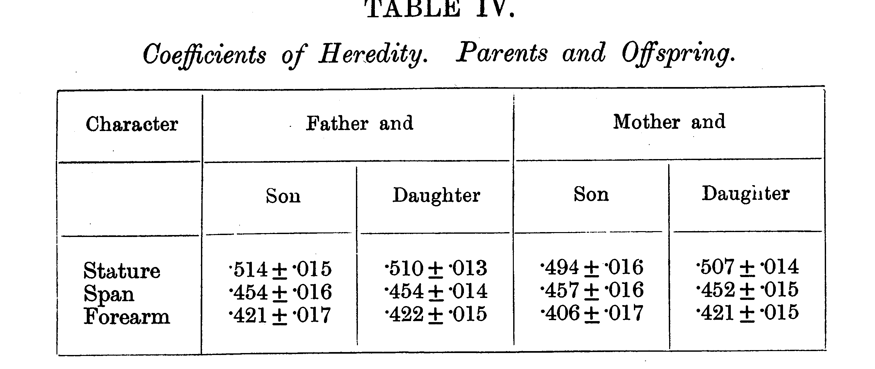
From Pearson and Lee (1903) p.378

Slide 37
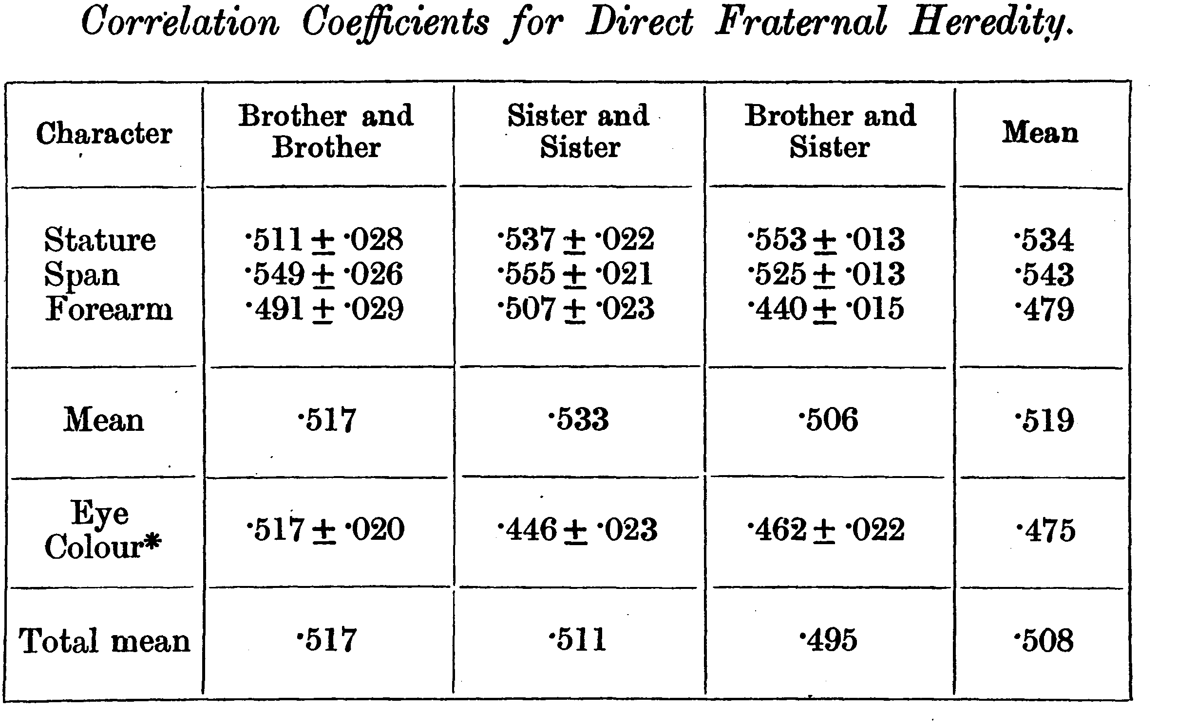
From Pearson and Lee (1903) p.387

Slide 38
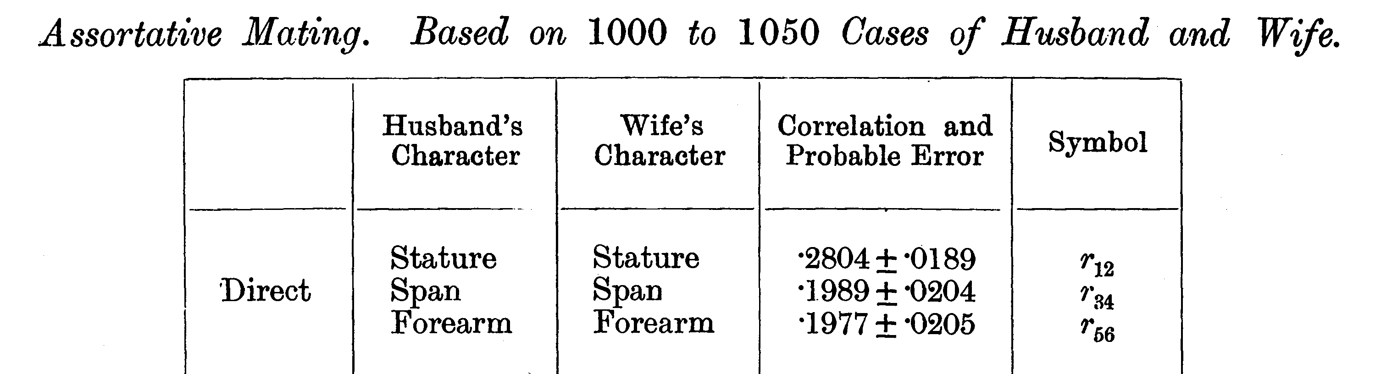
From Pearson and Lee (1903) p. 373

Slide 39
Modern Data
The Virginia 30,000 (N=29691)
The Australia 22,000
(N=20480)

Slide 40
ANZUS 50K: Extended Kinships of Twins
Parents of Twins
Siblings of Twins
Spouses of Twins
Twins
Offspring of Twins
© Lindon Eaves, 2009

Slide 41
Overall sample sizes
Relationship | # of pairs
Parent-offspring Siblings | 25018 18697
Spouses | 8287
DZ Twins MZ Twins | 5120 4623

Slide 42
Nuclear Family Correlations for Stature
(Virginia 30,000 and OZ 22,000)
© Lindon Eaves, 2009
Notes:
Notice: effects of mother and father equal; correlations for sibs close to parents;
Slight correlation between mates (assortative mating).

Slide 43
Nuclear Family Correlations for Stature and Liberalism/Conservatism
(Virginia 30,000)
© Lindon Eaves, 2009
Notes:
Compare with stature: notice how much greater assortative mating.

Slide 44
Nuclear Family Correlations for Liberalism/Conservatism
(Virginia 30,000 and Australia 22,000)
© Lindon Eaves, 2009

Slide 45
Nuclear Family Correlations for Stature and EPQ Neuroticism
(Virginia 30,000)
© Lindon Eaves, 2009

Slide 46
Nuclear Family Correlations for Socially Significant Variables
(Virginia 30,000)
© Lindon Eaves, 2009

Slide 47
Nuclear Family Correlations for Socially Significant Variables
(Australia 22K)
© Lindon Eaves, 2009

Slide 48
The (Really!) BIG Problem
Families are a mixture of genetic and social factors

Slide 49
A Basic Model
Phenotype=Genotype+Environment
P=G+E {+f(G,E)}
f(G,E) = Genotype-environment interaction and correlation

Slide 50
A Basic Model
Phenotype=Genotype+Environment
P=G+E {+f(G,E)}
f(G,E) = Genotype-environment interaction and correlation

Slide 51
Francis Galton (1822-1911)
1869: Hereditary Genius
1883: Inquiries into Human Faculty and its Development
1884-5: Anthropometic Laboratory at “National Health Exhibition”
Notes:
Astonishing intellectual curiosity: 3-volume biography by his graduate student (Karl Pearson). Self-styled “gentleman”
i.e. didn’t need to earn his living. Could afford to do research. Many interests: numbers (devised vest with grid of pockets to accumulate contingency table from observations); finger-prints; composite photographs; family history (pedigree methods); statistics (devised correlation coefficient);
Measured family resemblance; collected first “twin” data (though Augustine hit on the method in the 4th Cent. Ch. 5 of Civitas Dei.)

Slide 52
Galton’s Solution:
      Twins
      (Though Augustine may have got there first – 5th cent.)

Slide 53
One (?ideal) solution
Twins separated at birth

Slide 54
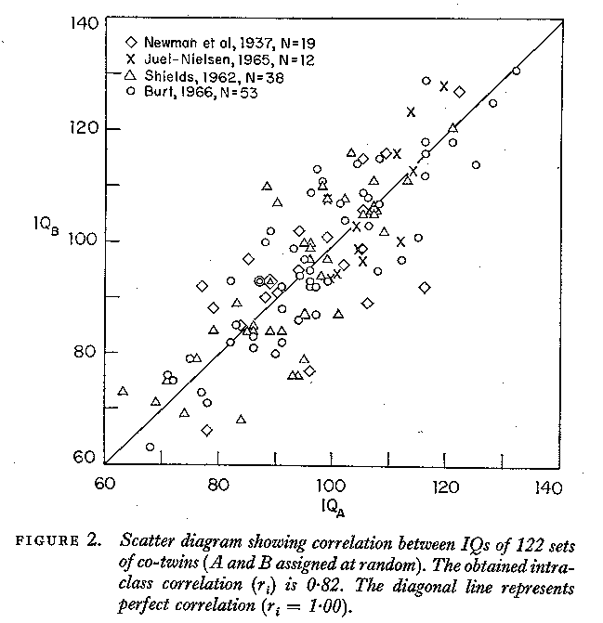

Slide 55
But separated MZs are rare

Slide 56
An easier alternative:
Identical and non-identical twins reared together:
Galton (Again!)

Slide 57
IDENTICAL TWINS
MONOZYGOTIC: Have IDENTICAL genes (G)
Come from the same family (C)
Have unique experiences during life (E)

Slide 58
FRATERNAL TWINS
DIZYGOTIC: Have DIFFERENT genes (G)
Come from the same family (C)
Have unique experiences during life (E)

Slide 59
Figure 9. The correlation between twins for stature (data from the Virginia Twin Study of Adolescent Behavioral Development).
Data from the Virginia Twin Study of Adolescent Behavioral Development

Slide 60
Data from the Virginia Twin Study of Adolescent Behavioral Development

Slide 61
Twin Correlations for Adult Stature
(Virginia 30,000 and Australia 22,000)
© Lindon Eaves, 2009

Slide 62
Twin Correlations for Stature and Liberalism
(Virginia 30,000 and Australia 22,000)
© Lindon Eaves, 2009

Slide 63
Twin Correlations for Stature and Liberalism
(Virginia 30,000 and Australia 22,000)
© Lindon Eaves, 2009

Slide 64
Twin Correlations for Socially Significant Variables
(Virginia 30,000)
©
Lindon Eaves,
2009

Slide 65
Twin Correlations for Socially Significant Variables
(Australia 22,000)
© Lindon Eaves, 2009

Slide 66
Twin correlations for gene expression
York et al.

Slide 67
“Quantitative Genetics”
Analysis of the patterns and mechanisms underlying variation in continuous traits to resolve and identify their genetic and environmental causes.

Slide 68
Gregor Mendel (1822-1884)
1865: “Experiments in Plant Hybridization”
Notes:
Subsequent research showed: a) Mendel’s theory applied to other species; b) applied to humans (inborn errors of metabolism);
c) Mendel’s laws mirrored by behavior of chromsomes at meiosis; d) chromosomes were repositories of genetic information encoded in DNA.

Slide 69
Karl Pearson (1857-1936)
1903: On the Laws of Inheritance in Man: I Physical Characteristics (with Alice Lee)
1904: II Mental and Moral Characteristics
1914: The Life, Letters and Labours of Francis Galton

Slide 70
“Mendelian” Crosses
with Quantitative Traits

Slide 71
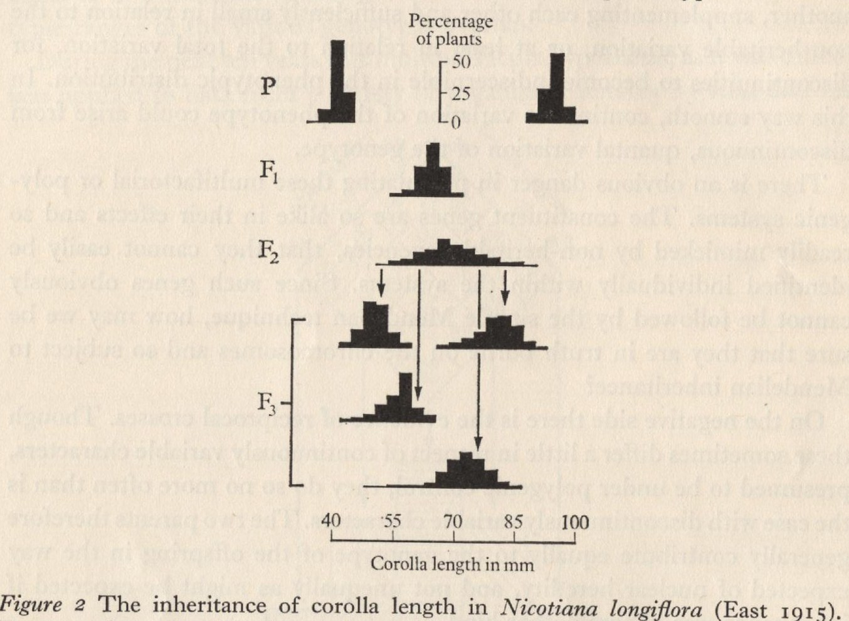
Mendelian Basis of Continuous Variation?
Experimental Breeding Experiments

Slide 72
Experiments Show:
Variation within inbred lines: Environment
F₁’s typically show same within-line variation
F₂’s more variable: Mirrors Mendelian segregation of Mendel’s classical hybridization experiments
Average differences between individual F₂ plants continue to progeny generations (F₃’s etc.)

Slide 73
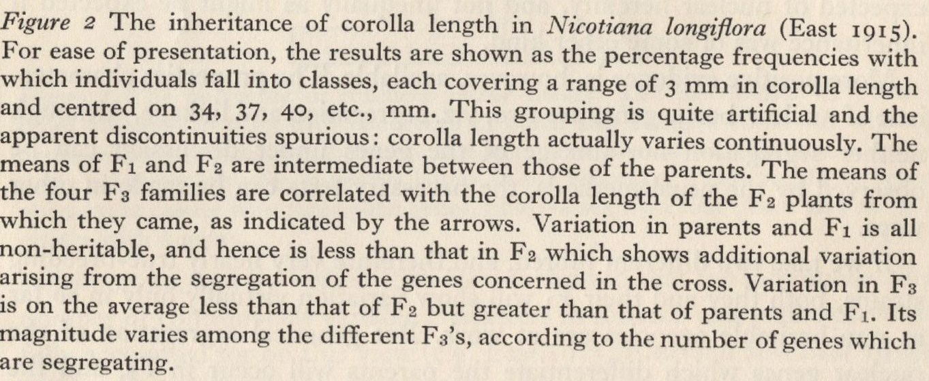
Description of East’s Experiment

Slide 74
Ronald Fisher (1890-1962)
1918: On the Correlation Between Relatives on the Supposition of Mendelian Inheritance
1921: Introduced concept of “likelihood”
1930: The Genetical Theory of Natural Selection
1935: The Design of Experiments

Slide 75
Fisher developed mathematical theory that reconciled Mendel’s work with Galton and Pearson’s correlations

Slide 76
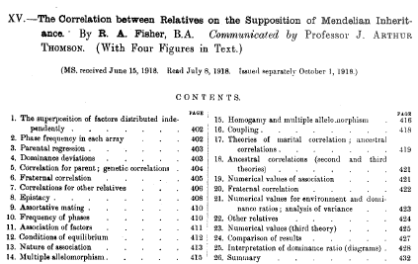

Slide 77
a.
b.
c.

Slide 78
Fisher (1918): Basic Ideas
Continuous variation caused by lots of genes (“polygenic inheritance”)
Each gene followed Mendel’s laws
Environment smoothed out genetic differences
Genes may show different degrees of “dominance”
Genes may have many forms (“mutliple alleles”)
Mating may not be random (“assortative mating”)
Showed that correlations obtained by e.g. Pearson and Lee were explained well by polygenic inheritance

Slide 79
Kenneth Mather 1911-1990
John Jinks 1929-1987

Slide 80
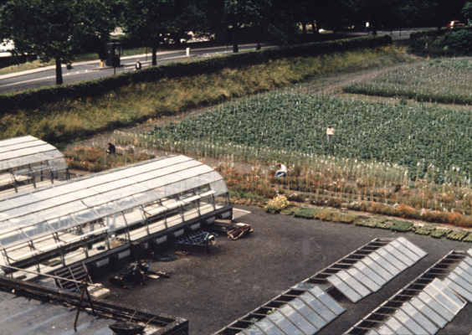

Slide 81
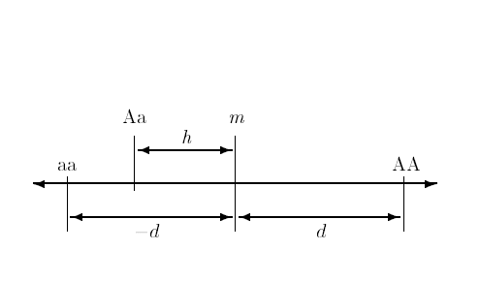
Basic Model for Effects of a Single Gene on a Quantitative Trait
Mid-homozygote
Decreasing
Increasing
Dominance
deviation
Homozygous effect

Slide 82
Parallel (“duplicate”) genes
Sequential (“complementary”) genes
A
A
aa
B
aa
bb
bb
B
C
= Pathway blocked by mutant gene

Slide 83
Combining pathways
Complementary Genes
Phenotypic
Response
Additive
Duplicate Genes
Dose of Bad Alleles

Slide 86
“The Logic of Scientific Discovery”
NO
Fits?
YES
Revise
Publish
estimates
Model-Fitting
Theory
Model
Data
Model-building
Study design
Data collection

Slide 87
Statisical approach
“Likelihood” (Fisher)
Some models and values of quantities (“parameters”, V_{A}, V_{D} etc) are “unlikely” to produce the data.
Choose those parameters values for that make the data “most likely”, i.e. maximum likelihood.
General statistical approach: applied widely in genetics

Slide 88
Example: Log-likelihood of twin correlations for different genetic contributions
Log-likelihood
Maximum likelihood
Maximum likelihood
estimate
Assumed genetic contribution (% Total)
Notes:
Start with correlations: MZ= 0.5 ; DZ= 0.3, N=200 pairs.

Slide 90
Path diagram for the effects of genes and environment on phenotype
Genotype
Environment
G
r
Latent variables
E
h
e
P
Measured variable
Phenotype

Slide 91
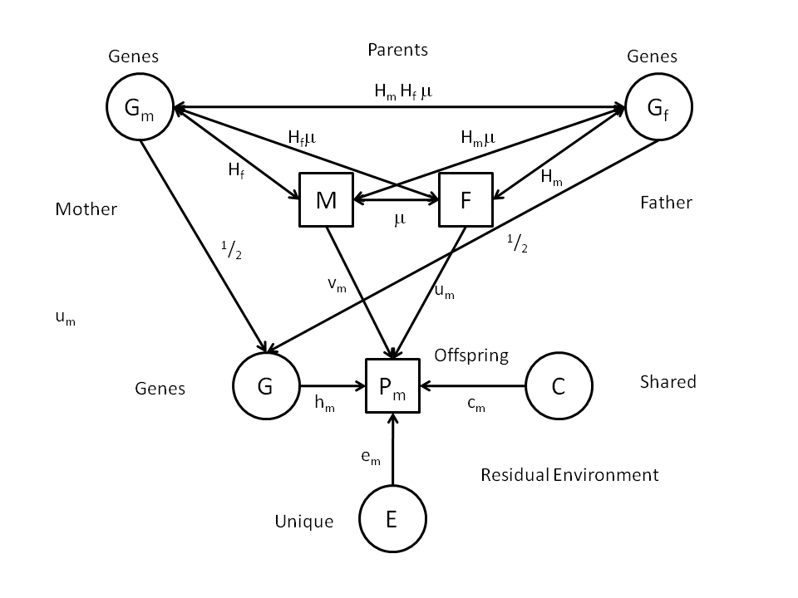
Genetic AND Cultural inheritance?
Notes:
Diagram shows possible causes – called “Path Diagram” (Sewall Wright, 1921).
Will deal with these later in the course.

Slide 92
Multiple Variables

Slide 93
F
N
V
S
U_{N}
U_{V}
U_{S}

Slide 94
EN₁
EV₁
ES₁
Specific
Environments
N₁
V₁
S₁
Twin 1
G₁
Common Genes
g
G₂
Twin 2
N₂
V₂
S₂
Specific
Environments
EN₂
EV₂
ES₂

Slide 95
Development

Slide 96
a. Genetic variation in developmental change: time series with common genes and time-specific environmental “innovations”
Genes
G
h
h
h
h
h
Phenotype
T0
b
T1
b
T2
b
T4
b
T5
Age
e
e
e
e
e
E1
E2
E3
E4
E5
Environment

Slide 98
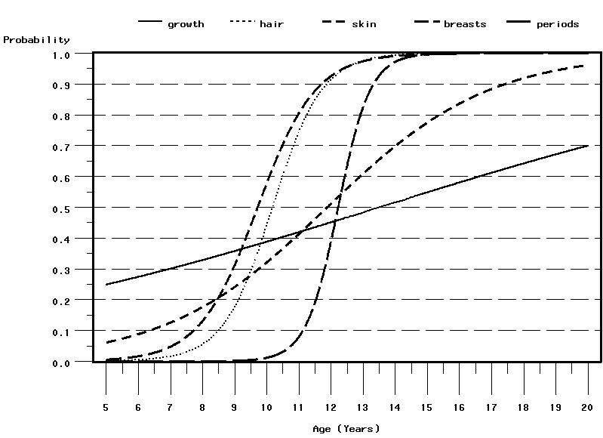
Probabilities of endorsing five puberty-related items in girls .
VTSABD (Eaves et al., 2002)

Slide 99
Genetic differences in growth
G1
Phenotype
G2
Genotypes
G3
Age

Slide 100
Random genetic and environmental effects in latent distribution of
pubertal advancement/delay relative to age in MZ and DZ girls.
Statistic | Mean | s.d. | 2.5%-ile | Median | 97.5%-ile
Total Variance | 1.171 | 0.130 | 0.953 | 1.155 | 1.470
% Additive Genetic | 76.0 | 6.4 | 62.0 | 76.2 | 87.5
% Shared Environment | 15.4 | 6.0 | 5.2 | 15.4 | 27.2
% Non-shared environment | 8.6 | 3.1 | 4.3 | 8.1 | 17.7
MZ correlation | 0.914 | 0.031 | 0.823 | 0.919 | 0.957
DZ correlation | 0.534 | 0.035 | 0.472 | 0.535 | 0.603
-2 ln(l) | 18880.0 | 58.52 | 18770.0 | 18890.0 | 19000.0

Slide 101
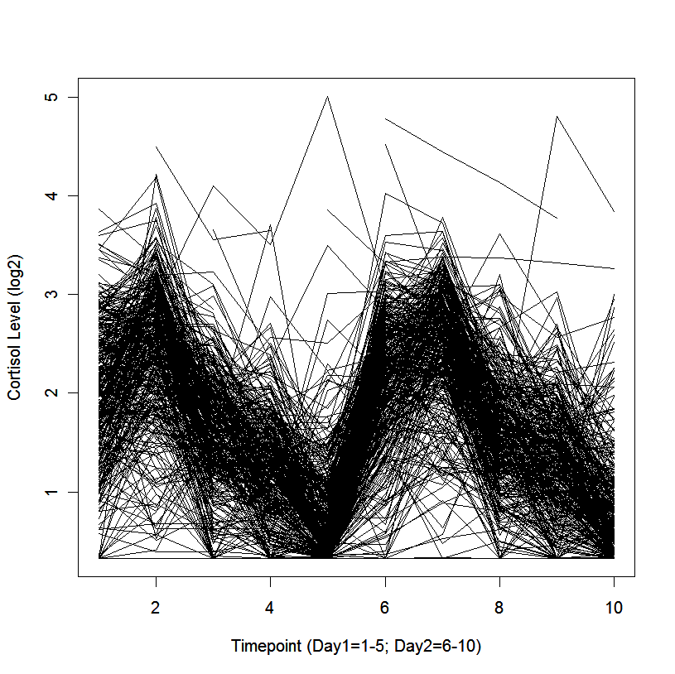
Data trend for days 1 and 2
Tim York

Slide 102
Attitudes over the life-span

Slide 103
Components of Variance in Adolescence

Slide 104
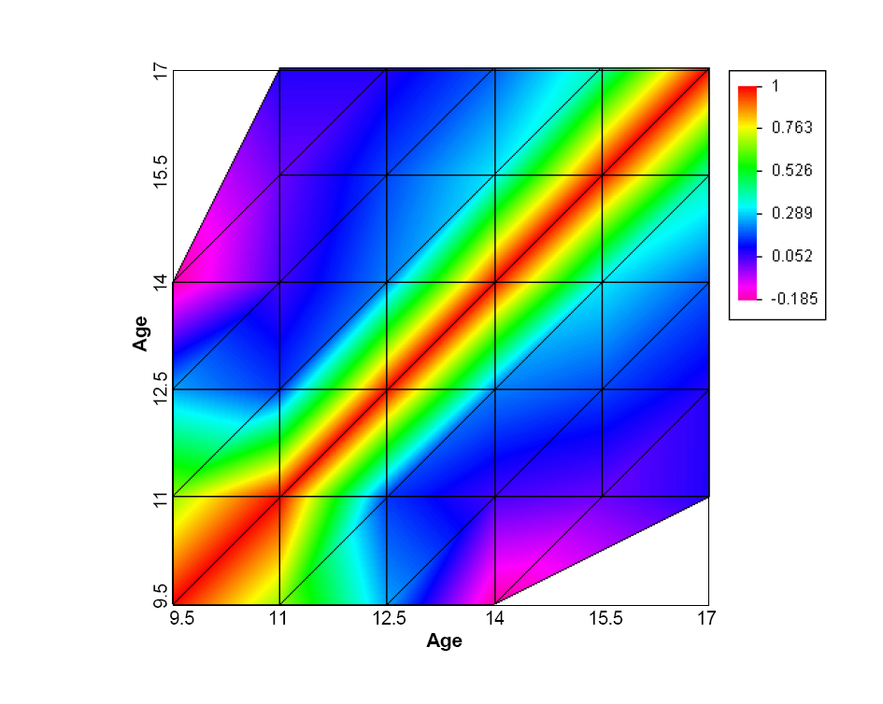
Cross-age correlations in unique environment

Slide 105
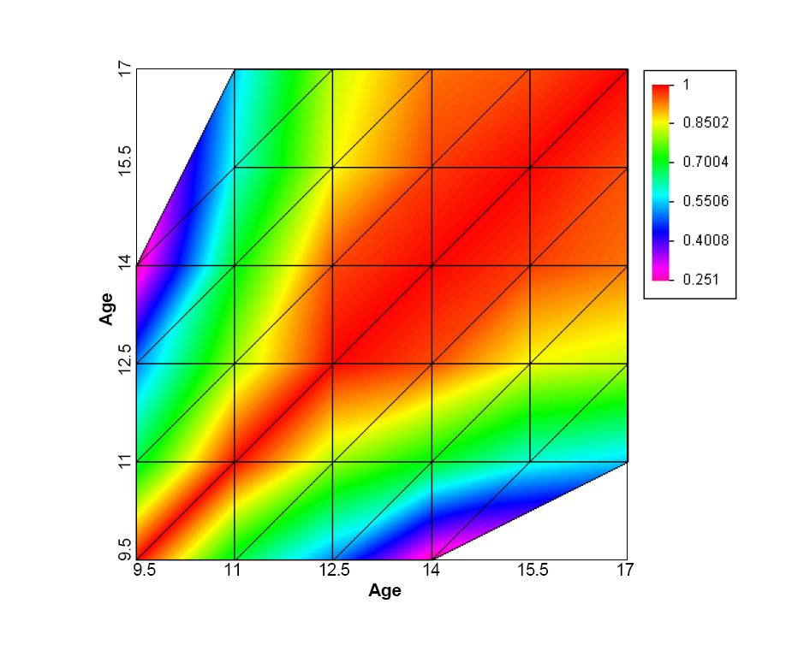
Cross-age correlations in shared environment

Slide 106
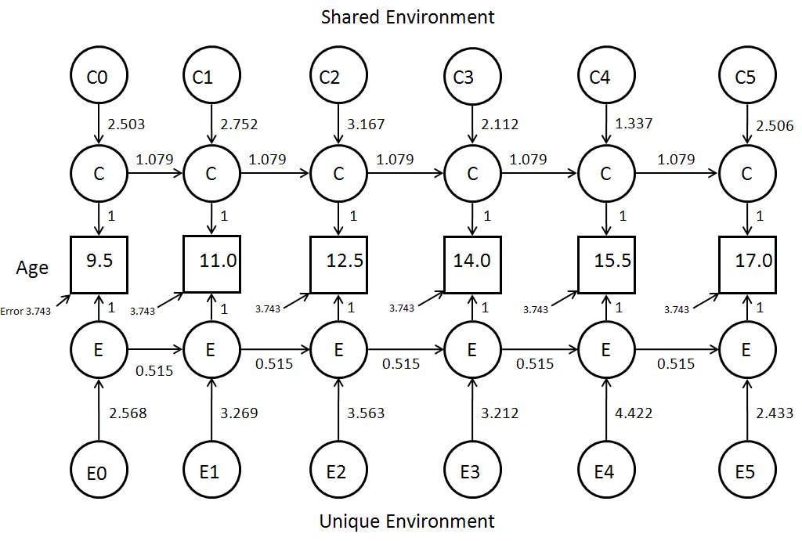
Model for Attitude Development

Slide 107
The Extended Phenotype
World
Parents
Me
Spouse
Siblings
Child
Extended Phenotype

Slide 108
“Mating”

Slide 109
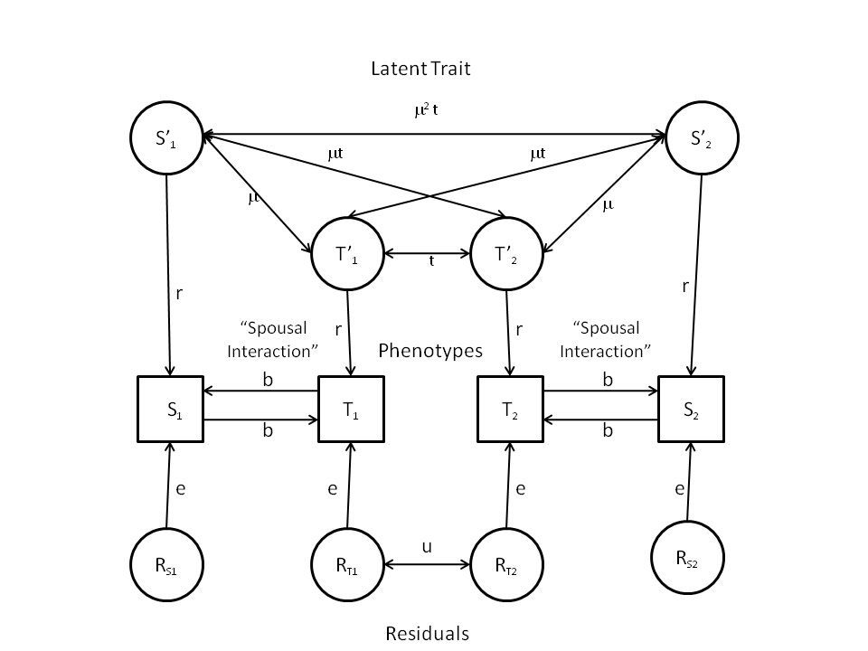
“Twins and Spouses”

Slide 110
Goodness-of-fit statistics for models for assortative mating in the US and Australia
Model |  | Random mating | Phenotypic assortment (P) | P+Error | Spousal Interaction | Social Homogamy
d.f. |  | 16 | 15 | 13 | 14 | 11
Variable | Sample | S² | S² | S² | S² | S²
Stature | US | 449.179 | 31.363 | 24.423¹ | 78.930 | 28.786
 | AU | 239.827 | 12.947 | 11.817¹ | 31.694 | 25.353
Conservatism | US | 2535.373 | 14.845 | 12.143 | 118.266 | 328.491
 | AU | 2041.407 | 31.627 | 29.669 | 113.276 | 239.123
Neuroticism | US | 63.371 | 17.811 | See note² | 20.226 | 19.458
 | AU | 28.337 | 17.444 | See note² | 15.583 | 22.807
Church attendance | US | 3375.872 | 15.187 | 12.841 | 103.042 | 611.006
 | AU | 3019.544 | 22.140 | 21.548¹ | 76.574 | 403.950
Political affiliation | US | 2213.625 | 22.254 | 18.500 | 87.889 | 429.819
 | AU | 2337.500 | 34.183 | 32.537 | 70.696 | 322.685
Educational attainment | US | 2477.957 | 46.210 | 28.207 | 243.100 | 57.774
 | AU | 1430.440 | 44.146 | 18.624 | 160.747 | 82.086

Slide 111
f(G,E)
Genotype x Environment Interaction (“GxE”)
Genotype-Environment Correlation
(“rGE”)

Slide 112
(“Passive”) rGE

Slide 113
Twins and Parents

Slide 114
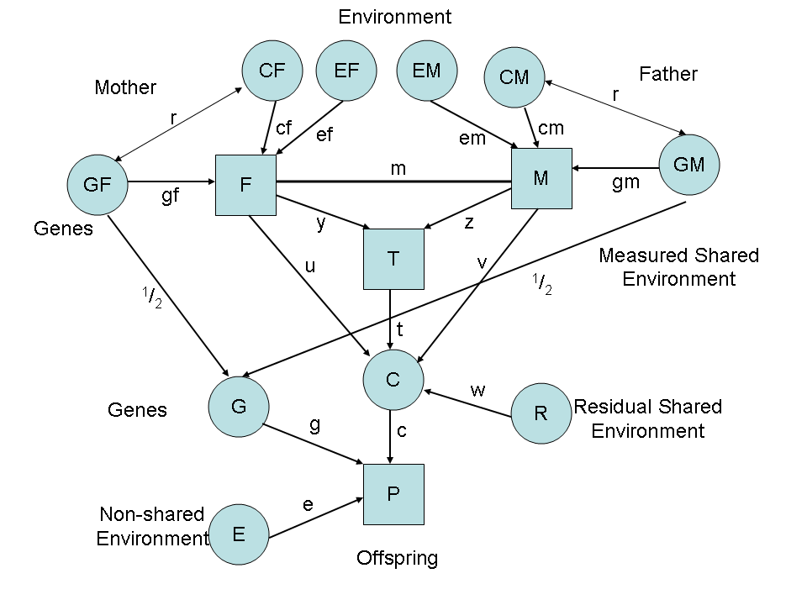
Parental Neglect and Anti-Social Behavior
Eaves et al., 2010

Slide 115
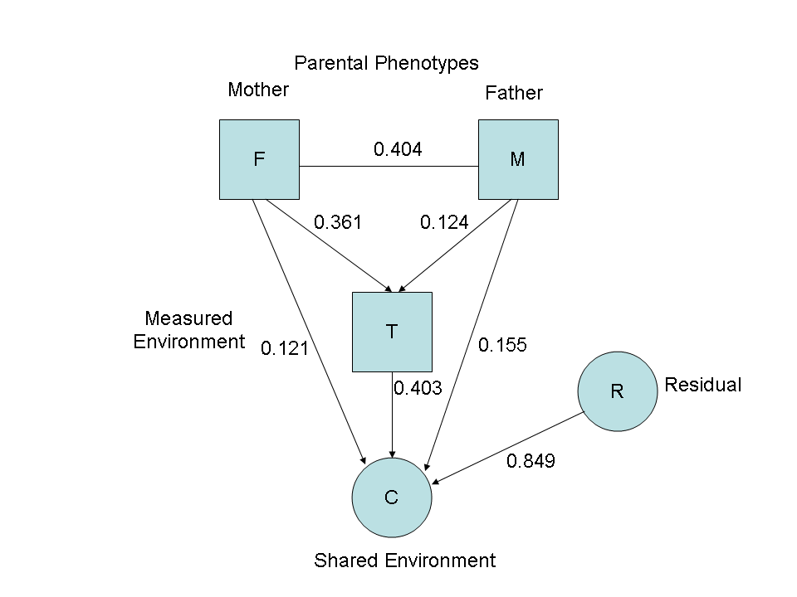
Environmental pathways

Slide 116
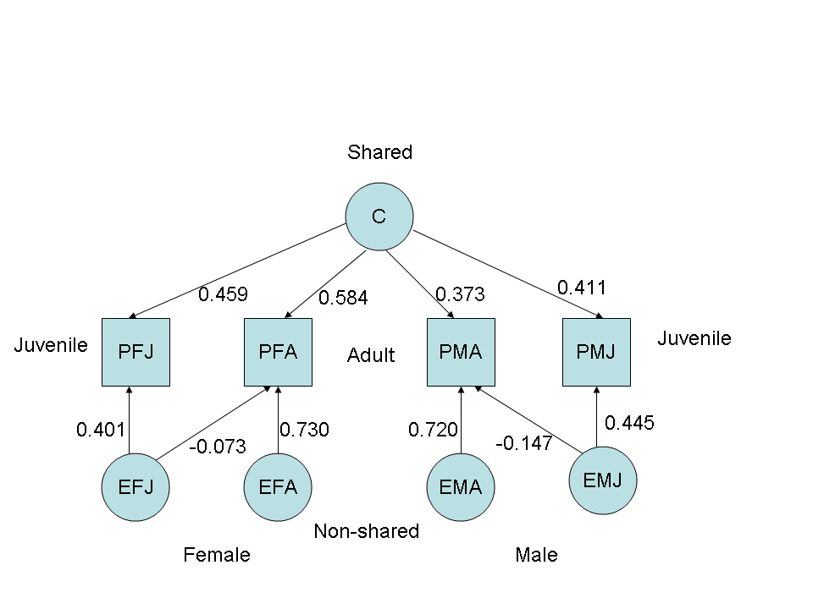
Shared and Unique Environment

Slide 117
GxE

Slide 118
Genetic Variance and Shared Life Events in Adolescent Females

Slide 119
Putting it all together?

Slide 120
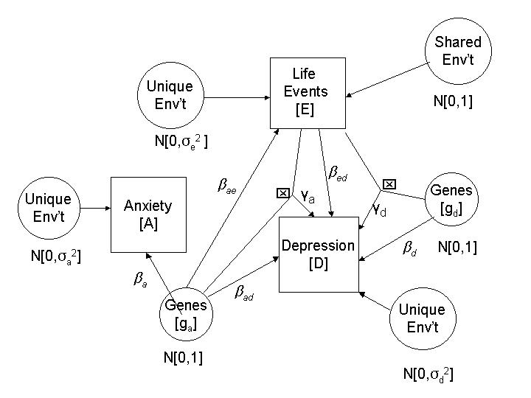
Multiple Genetic Pathways to Depression
Eaves et al. 2003

Slide 121
Have fun!!!

