Slide 1
Testing for Heterogeneity (Sex differences)
Danielle Dick, Hermine Maes,
Tim York

Slide 2
Sex Effects
Does the magnitude of genetic/environmental effects differ in males and females?

Slide 3
Sex Effects
Females
Males

Slide 4
Sex Effects
Females
Males
a_{F} = a_{M} ? c_{F} = c_{M} ? e_{F} = e_{M} ?

Slide 5
Sex Effects
Does the magnitude of genetic/environmental effects differ in males and females? (QUANTITATIVE)
With OS pairs: Are the same genes/environments acting in males and females (QUALITATIVE)

Slide 6
Sex Specific Effects
Inspecting the correlations from DZ like-sex and opposite-sex pairs can alert you to the presence of sex-specific effects if the OSDZ correlation is markedly less than the SSDZ correlations.

Slide 7
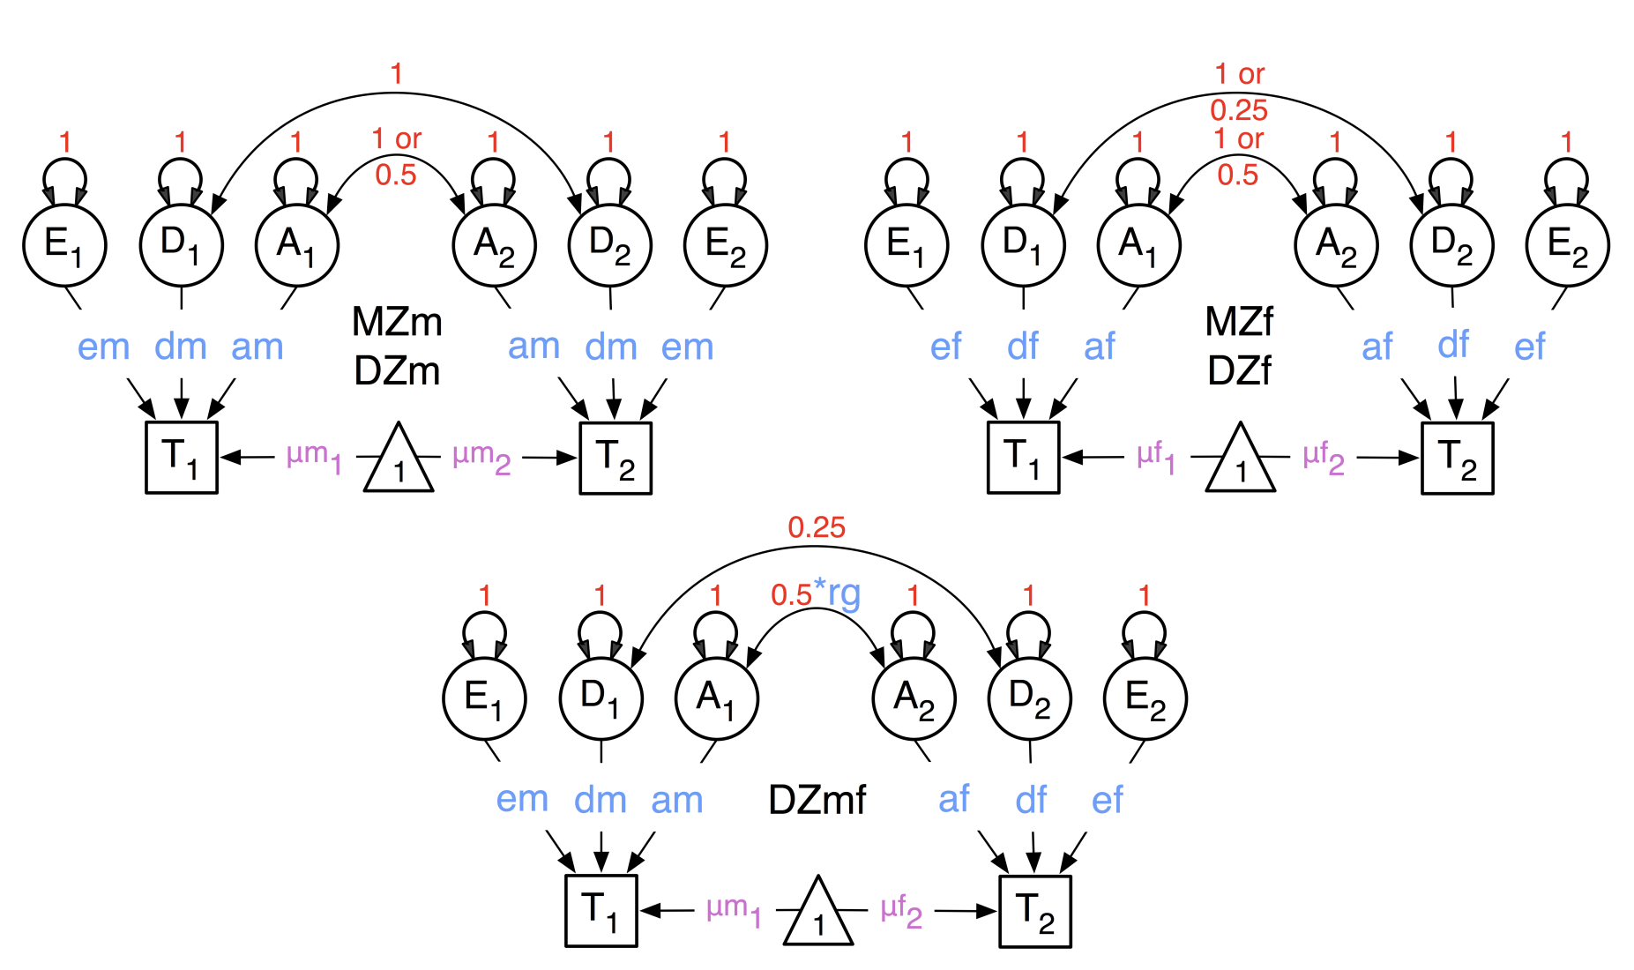
ADE heterogeneity model

